Slide 1
Hydraulic Fracturing:
Technological Advances
David R. Mica
Executive Director
Florida Petroleum Council
www.EnergyTomorrow.org

Slide 2
Florida Petroleum Council
Division of the American Petroleum Institute
Represent All Segments of the Petroleum Industry
  Exploration
  Production
  Refining
  Transportation
  Retailing

Slide 3
Florida Energy Perspective
3rd in Population and growing
Over 105 million tourists / year
3rd in Gasoline/Diesel Consumption
Over 10 billion gallons of gasoline and diesel sold annually
~27 million gallons of gasoline and diesel per day

Slide 4
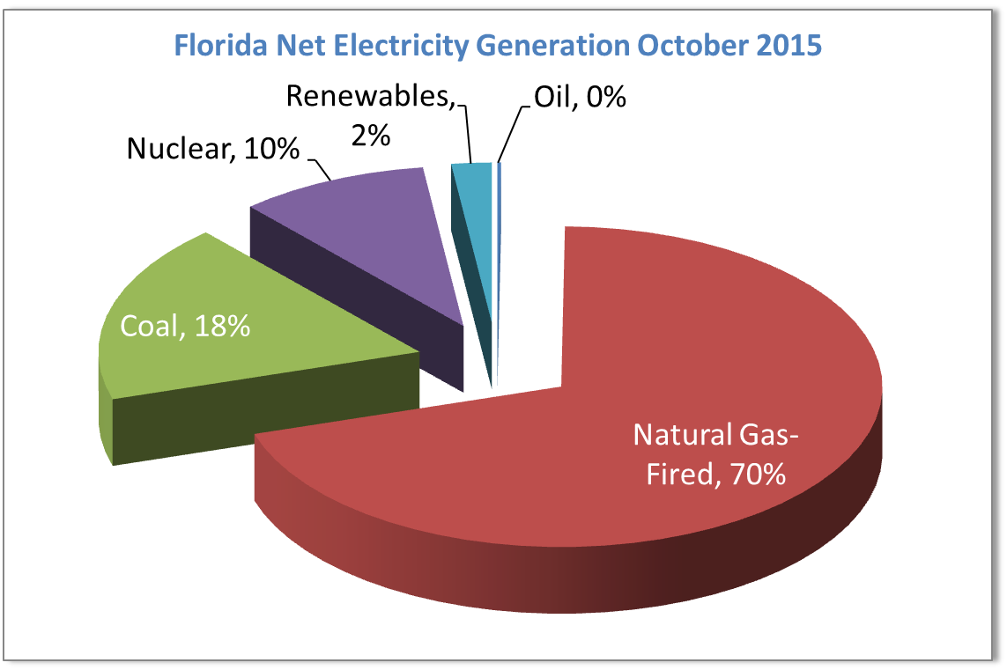
Source: U.S. Energy Information Agency

Slide 5
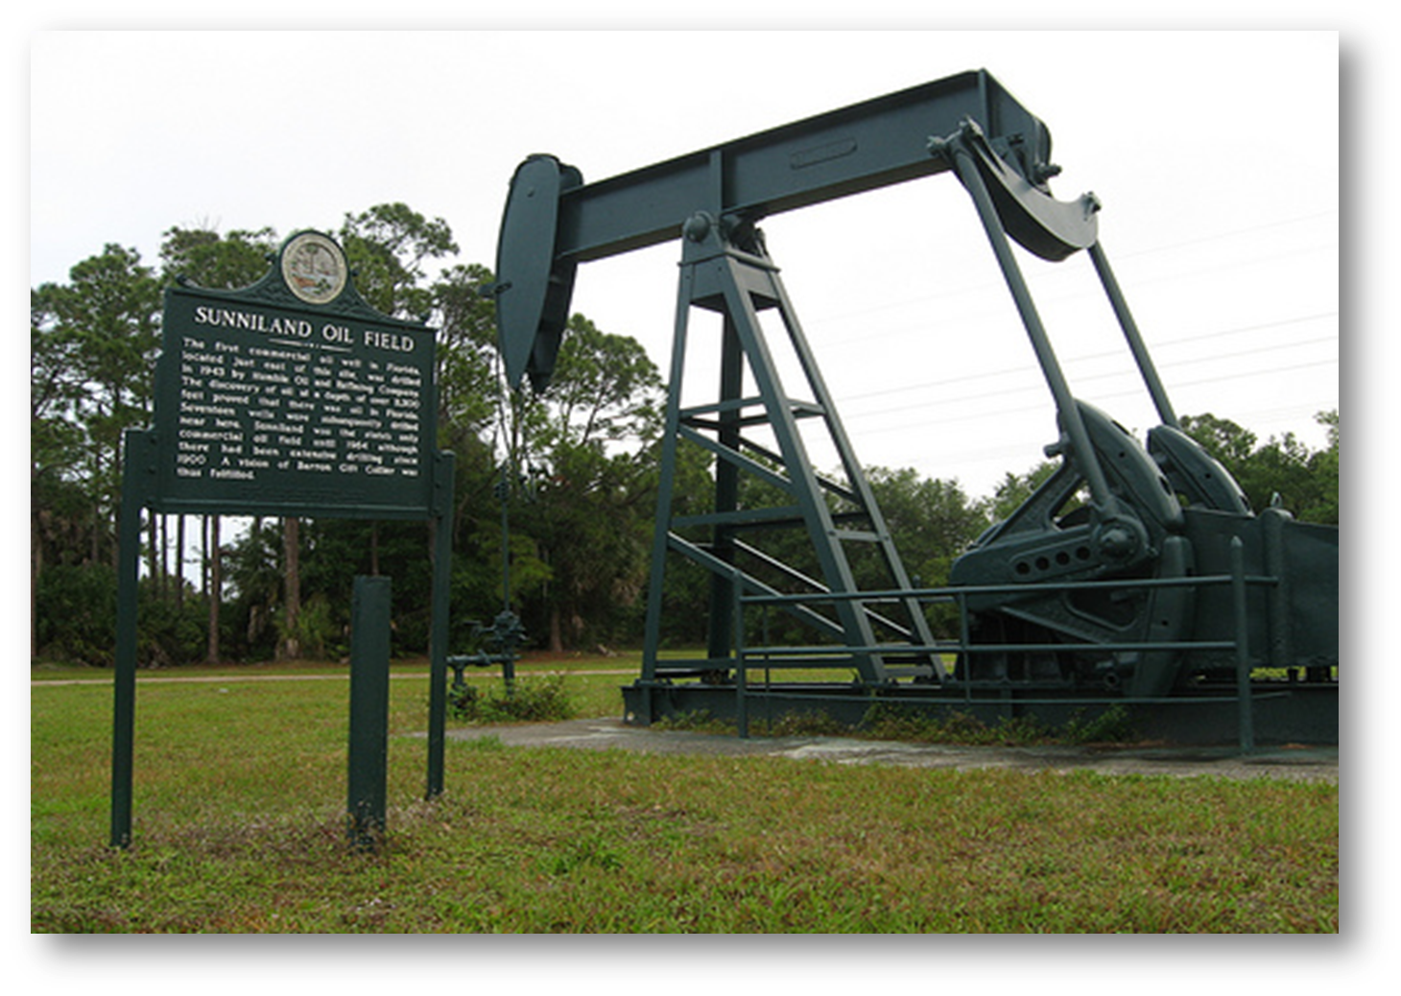

Slide 6
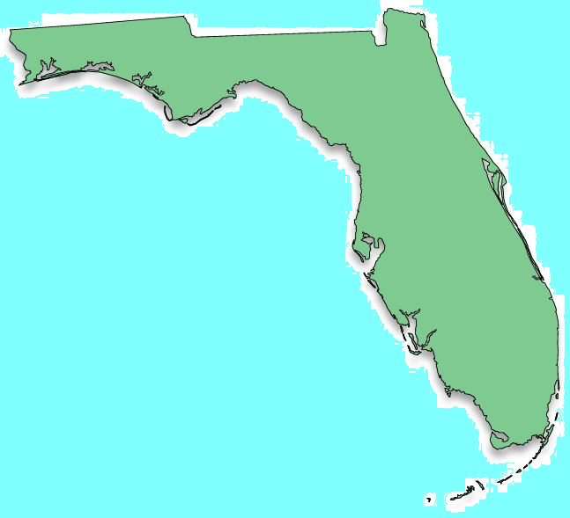
Long History of Florida Oil and Gas Production
West Felda (1966)
Bear Island
(1972)
Jay (1970)
Blackjack Creek
(1972)
1970’s: Florida ranked 9th in state oil production
611 million barrels of crude oil
689 billion cubic feet of natural gas
Sunniland
(1943)
Raccoon Point
(1978)

Slide 7
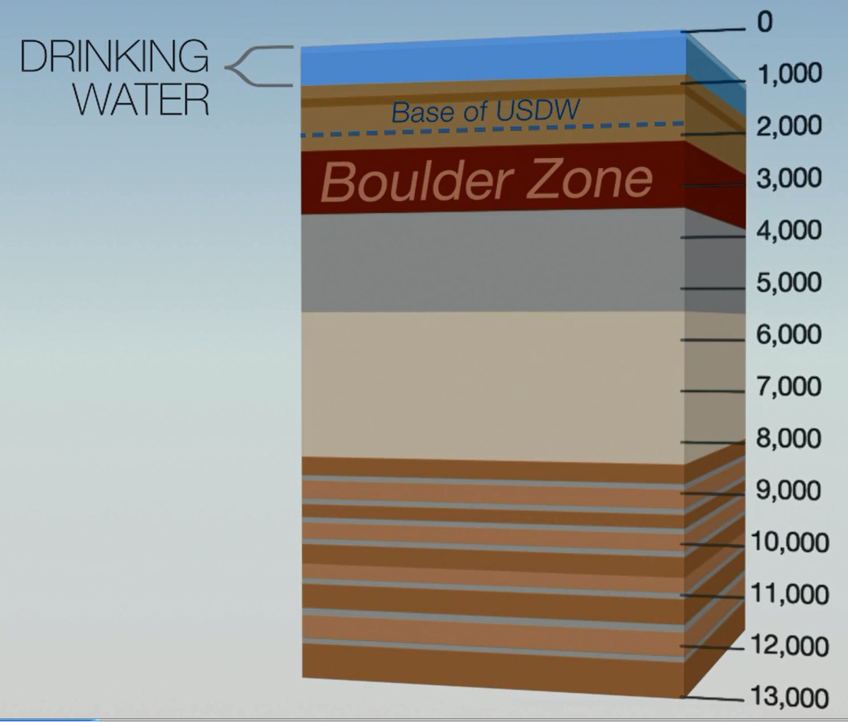

Florida Geology
(Karst geology in this layer)
IMPERMEABLE
ROCK
OIL ZONE

Slide 8
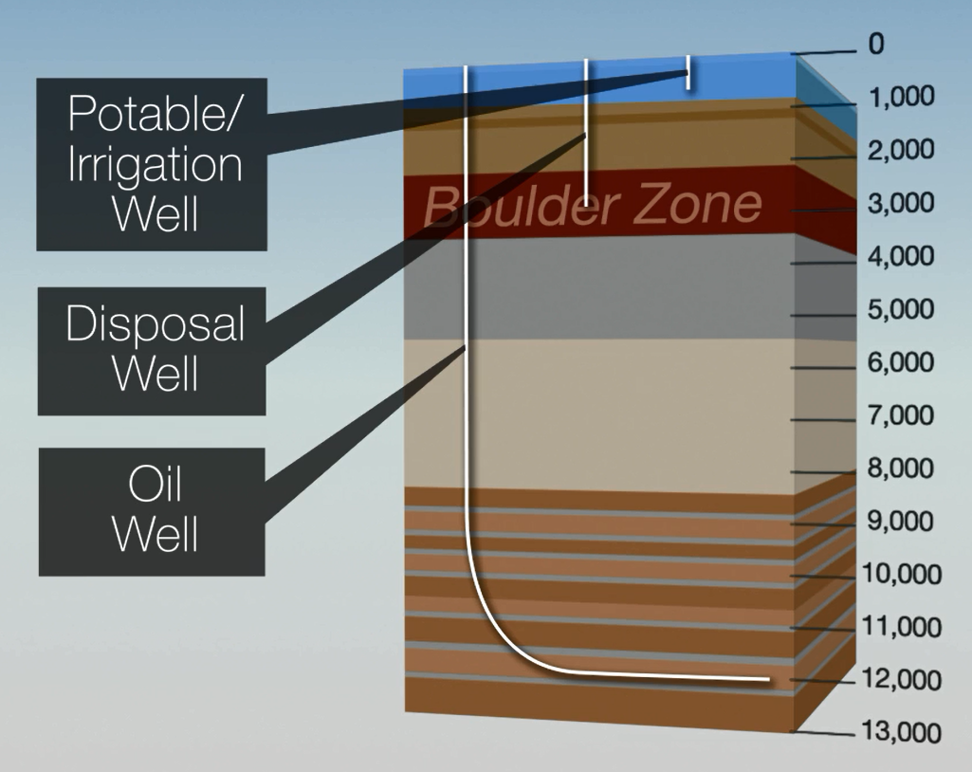
Wells Typically Drilled through Florida’s Geology

Slide 9
Stages of Oil and Natural Gas Production
Well Construction (Drilling)
  Approximately 30 – 90 days
  Note – Hydraulic fracturing is not a drilling process.
Well Stimulation
  Approximately 2 – 5 days
  Optimizing the well for Production
  Acidation, Matrix Acidation, Hydraulic Fracturing
Production
  Extracting the Natural Gas and/or Oil
  Approximately 20 – 40 years

Slide 10
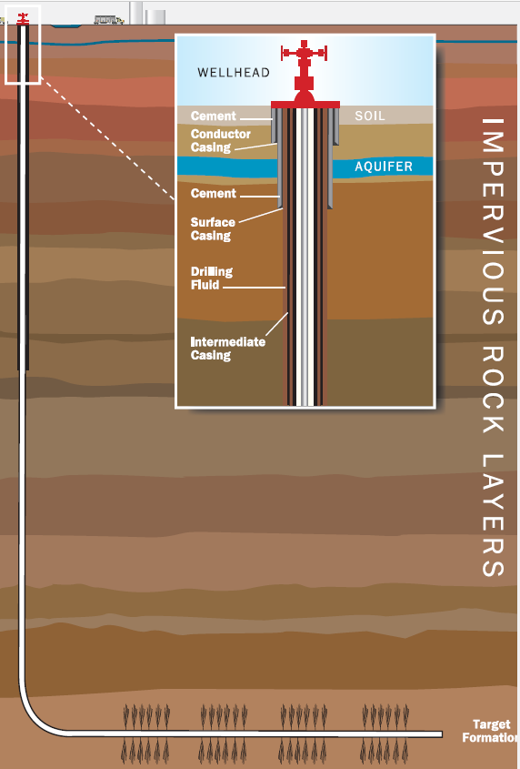
Well Construction

Slide 11
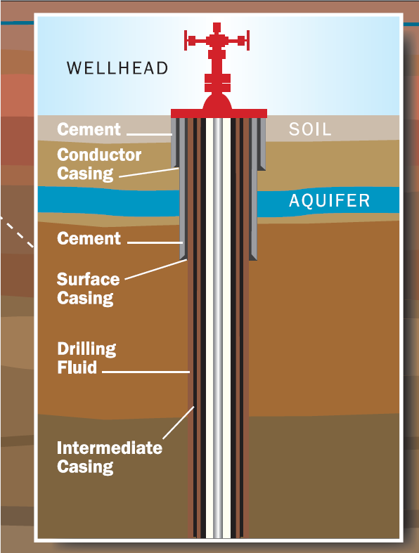

Slide 12
Well Stimulation – Hydraulic Fracturing
Water is injected at sufficient pressures to create fissures in the oil zone rock to release more oil and/or natural gas
Sand, included in the water, is used as a proppent to keep the fissures open
Other ingredients are added to facilitate the fracturing and extraction process

Slide 13
Hydraulic Fracturing – Established Technology
Technology established in 1940’s
Established to extract shale oil and natural gas
Over 1 million wells drilled
Over 7 billion barrels of oil produced
Over 600 trillion cubic feet
Technology blossomed in early 2000’s

Slide 14
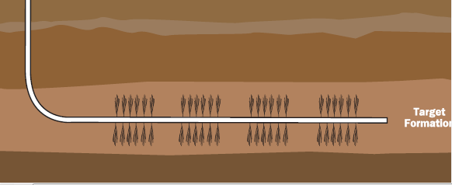
Well Stimulation – Hydraulic Fracturing
Note: the Oil Zone is two miles below the aquifer
separated by impermeable rock
Note: the fractures remain in the Oil Zone

Slide 15
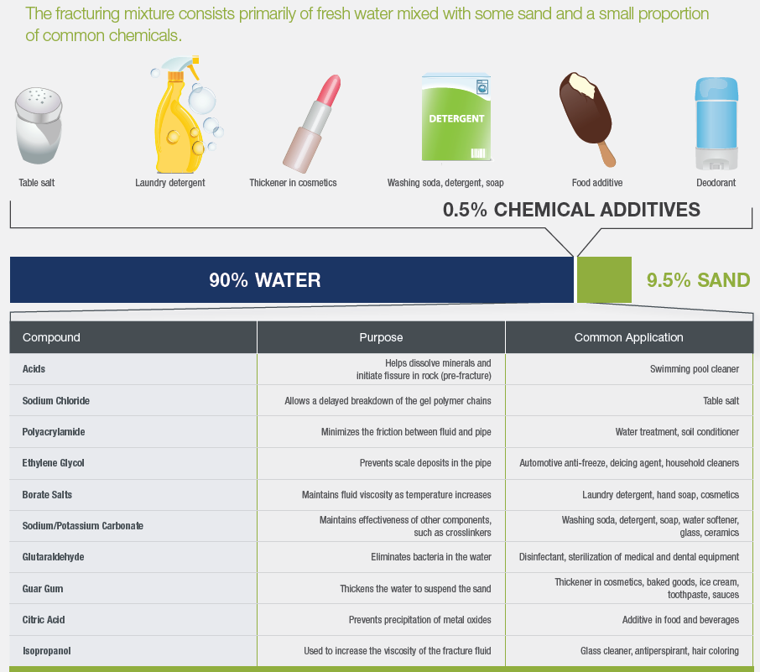
Hydraulic Fracturing Fluid

Slide 16
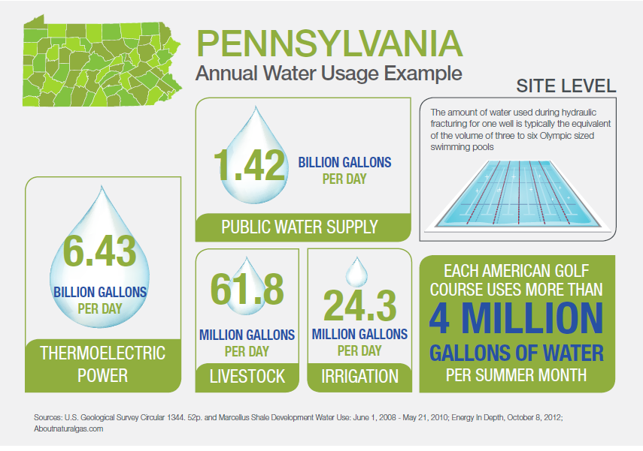
Pennsylvania HF Water Usage / Day: 1.9 million gallons

Slide 17
EPA Permitted Injection Area
Disposed similarly to municipal and industrial waste water
Boulder Zone – Porous geologic layer containing heavily brackish water
Eliminates threats of enhanced seismic activity

Slide 18
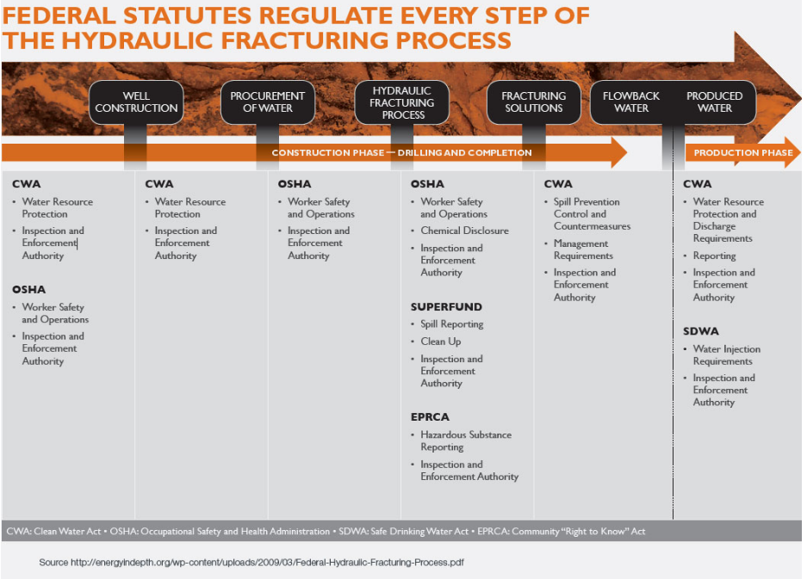

Slide 19
Hydraulic Fracturing Success
U.S. is now the largest energy producer in the world
U.S. oil production has increased from 5 million to 9 million barrels per day
50% of domestic oil production from HF wells
Supports 9.8 million jobs

Slide 20
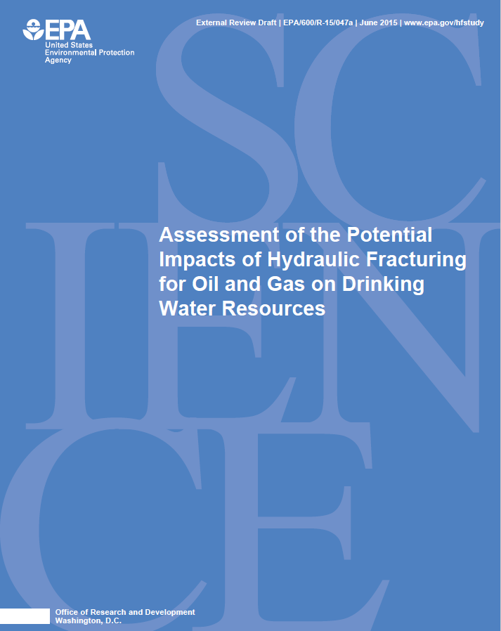
EPA Report Finds Fracking Safe
EPA produced data revealing “no evidence that fracking has any systemic groundwater impacts”
6,800 sources of drinking water for public water systems located within one mile of at least one hydraulically fractured well
Those water well sources served more than 8.6 million people
Peer reviewed

Slide 21
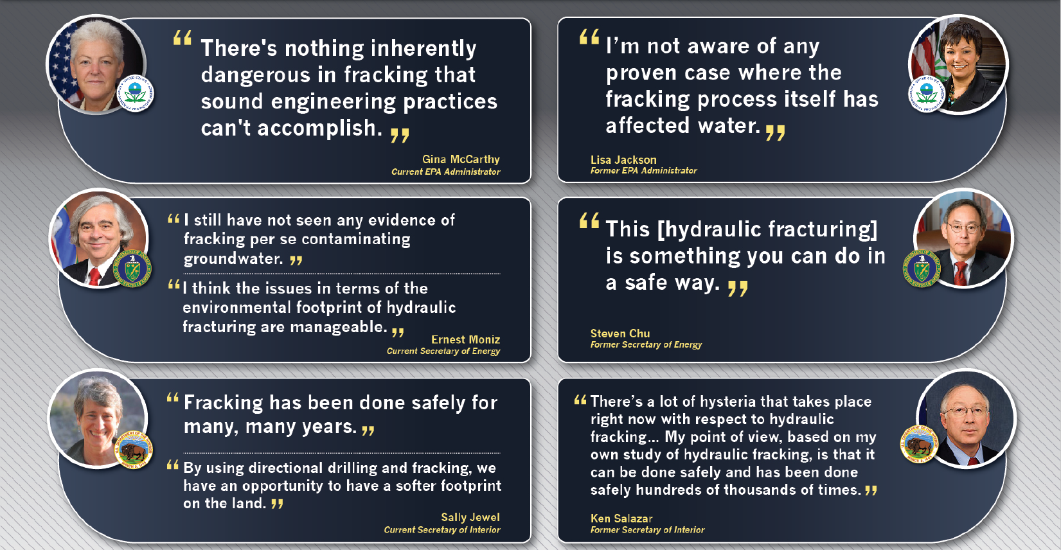
What do federal regulators say…

Slide 22
Other Stimulation Techniques: Aciditation
Used to clean up well scale and clear bore hole
Dilute acid – hydrochloric or citric acid
Reacts with calcium carbonate (holding the oil)
Totally neutralized to salt, water, and carbon dioxide
Used for decades in Florida

Slide 23
Other Stimulation Techniques: Matrix Aciditation
Used to slightly expand bore hole
Injected with slight pressure (below fracturing pressures)
Dilute acid – hydrochloric or citric acid
Reacts with calcium carbonate (holding the oil)
Totally neutralized to salt, water, and carbon dioxide
Used for decades in Florida

Slide 24
Benefits: More Domestic Oil and Gas Production has led to Lower Energy Prices

Slide 25
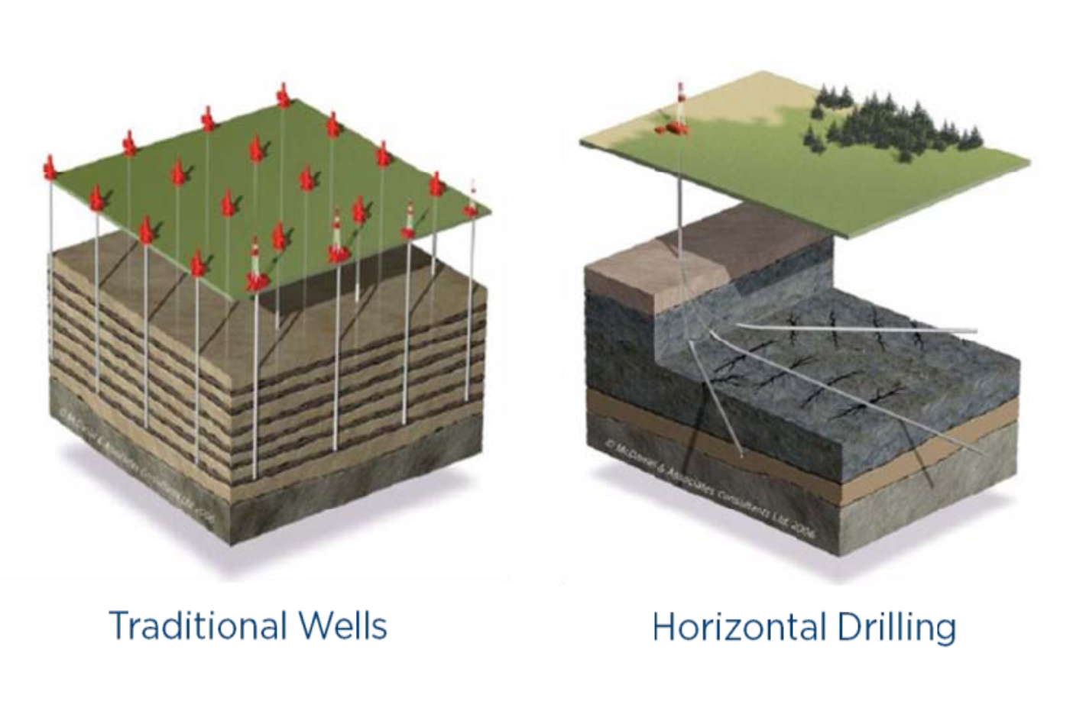
Benefits: Smaller Footprint for Access to Oil and Gas

Slide 26
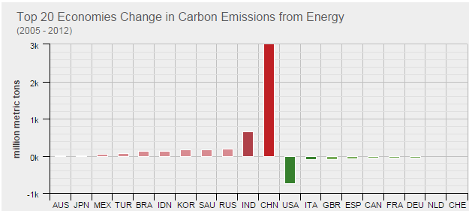
Benefits: U.S. Leads the World in CO₂ Reductions

Slide 27
Questions

Slide 28
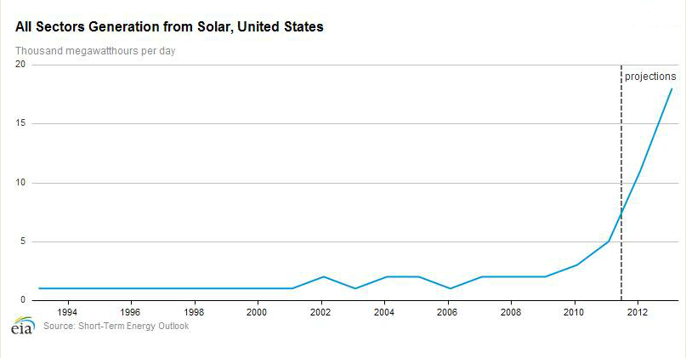

Slide 29
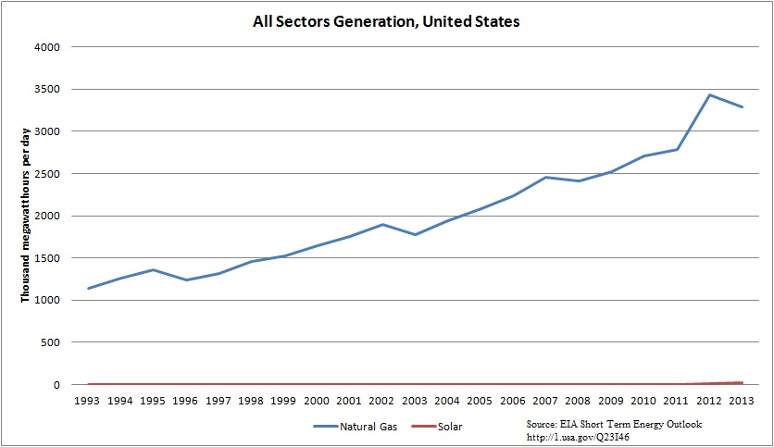

Slide 30
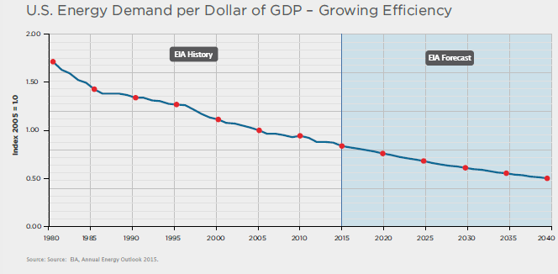
Efficiency Improves…Driven by Competition

Slide 31
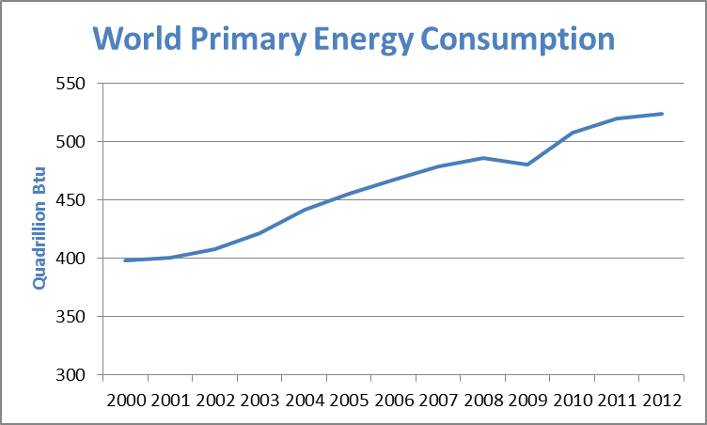
Energy Consumption Grows with Economies/Populations
Source: Energy Information Agency

