Slide 1
Natural Gas, Nuclear, And The Future of American Power
Robert Bryce presentation to:
Florida Gas Utility
Marathon, FL
8 October 2026
Notes:
Start with energy transition slides, go to media coverage, but what’s the reality? Nat gas is the key fuel.
What’s the past?
What’s happening now?
What is the future?
Nat is important for reliability
Abundnace,.
Demand for power burn
Math on renewables doesn’t work.
Coal plants will
Local Law 97
All electric new construction act.
Reliability affordability, energy security, and federal law are on your side.
People aren’t hearing the facts.
They are getting the spin. Media isn’t reporting the facts.
Include Empire Center report excerpts

Slide 2

Four Points:
  ● A brief history of natural gas
  ● Where’s that energy transition?
  ● AI: How much gas? How much power?
  ● N2N: Nat gas to nuclear
© Robert Bryce

Slide 3
But First:
Florida By The Numbers
● Nat gas plants produce ~ 75% of FL’s electricity
● FL is fifth-largest nat gas consumer in US
● In-state production is tiny (3.5 Bcf/yr, 0.01% of US)
● FL is second-largest electricity user after TX
● 54% of electricity is used in homes, lgst share in US
Source: EIA, https://www.eia.gov/state/print.php?sid=FL , https://www.eia.gov/state/rankings/?sid=US#/series/31 , https://www.eia.gov/energyexplained/natural-gas/use-of-natural-gas.php
© Robert Bryce

Slide 4



The Remarkable History Of American Natural Gas Is Personal
Source: Bryce family
©Robert Bryce

Slide 5


Oklahoma Natural Gas Co. Hired My Mom
To Teach Women How To Cook With Gas
Source: Bryce family
©Robert Bryce

Slide 6


My Mother Was A Pioneer Of Oklahoma TV.
In 1949, She Began Hosting “Lookin’ At Cookin’”
Source: Bryce family, KOTV
©Robert Bryce

Slide 7
Key Dates In CH₄ History
500 BC: Chinese use bamboo pipelines to harness natural gas seeping to surface
1785: “Town gas” first used in Britain for street lighting
1816: Baltimore becomes first US city to use town gas for street lighting
1825: First US natural gas production begins in Fredonia, NY
1836: Philadelphia Gas Works becomes first municipally owned gas company
1862: US has 420 chartered gaslight companies
1882: Edison Illuminating begins operating in Manhattan, ending gas lighting era
1949: Ann Mahoney starts working for ONG, US nat gas production is 14 Bcf/d
2026: US gas production hits 122 Bcf/d
Source: https://www.nps.gov/parkhistory/online_books/hcrs/myers/plate12.htm
https://www.apga.org/apgamainsite/aboutus/facts/history-of-natural-gas#:~:text=Around%20500%20B.C.%2C%20the%20Chinese,to%20light%20houses%20and%20streets.
https://www.eia.gov/todayinenergy/detail.php?id=54959
©Robert Bryce

Slide 8
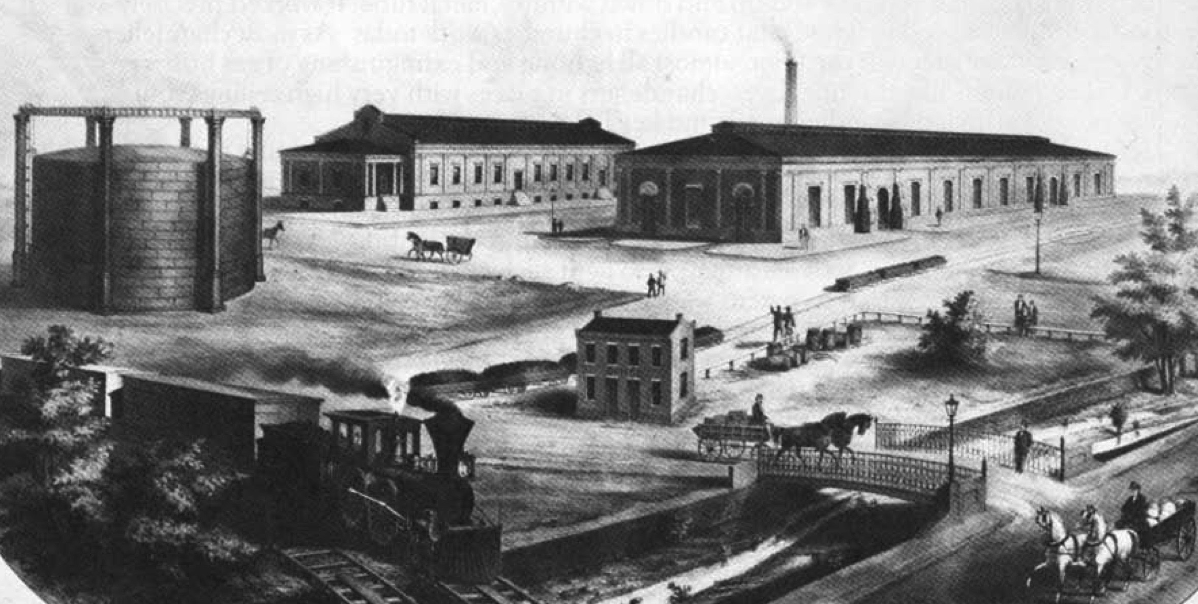
Lithograph of Peoples Gas Company of Baltimore, 1870
Source::https://www.nps.gov/parkhistory/online_books/hcrs/myers/plate12.htm
©Robert Bryce

Slide 9

Nineteen Years Ago, Everyone Knew The US Was Running Out Of Natural Gas
Gas production has peaked in North America...unless there’s some huge find that nobody has any idea where it would be.
— Lee Raymond, CEO,
Exxon Mobil, 2007
Source: https://www.reuters.com/article/world/exxon-says-n-america-gas-production-has-peaked-idUSN21633104/
© Robert Bryce

Slide 10
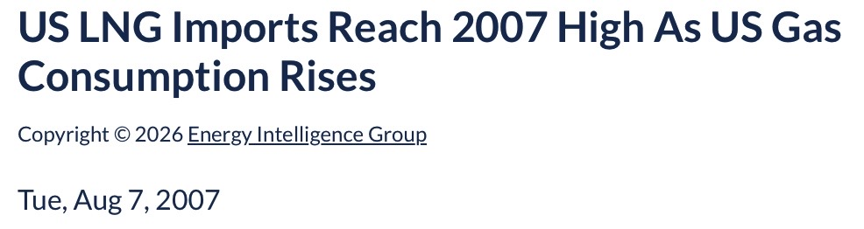
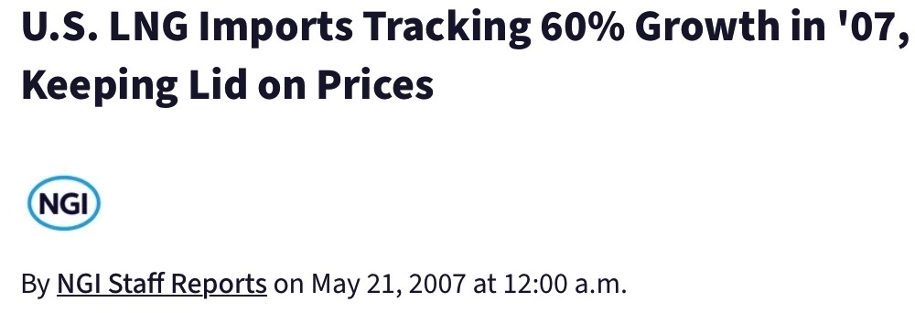
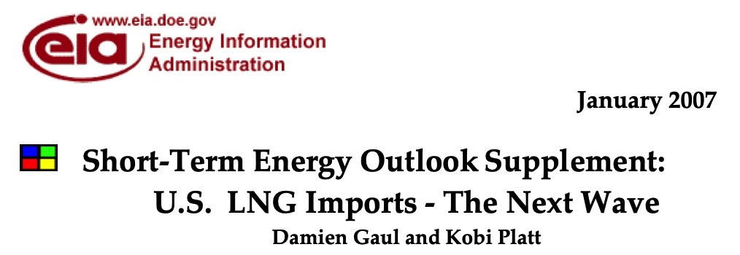
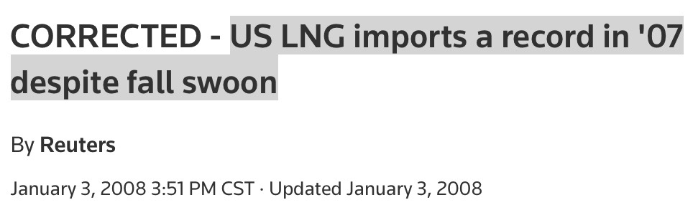
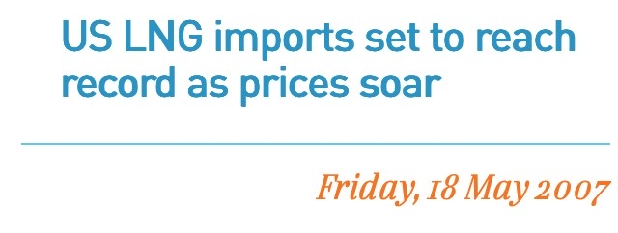
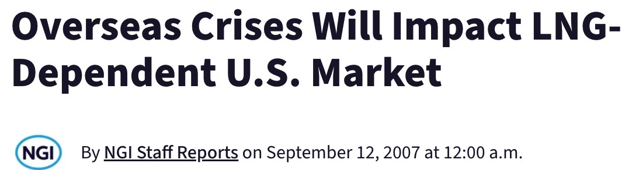
In 2007, The US Was Importing Record Amounts Of LNG
© Robert Bryce

Slide 11
What Has Happened Since 2007?
US Gas Production Soared
127.8
2007:
55.3 Bcf/d
55.3
Between 2007 and 2026, US gas production jumped by 122%
US natural gas production, Bcf/d, 2000 to 2027 (est.)
Source: EIA, https://www.eia.gov/dnav/ng/hist/n9050us2a.htm, https://www.eia.gov/outlooks/steo/data/browser/#/?v=15
© Robert Bryce

Slide 12
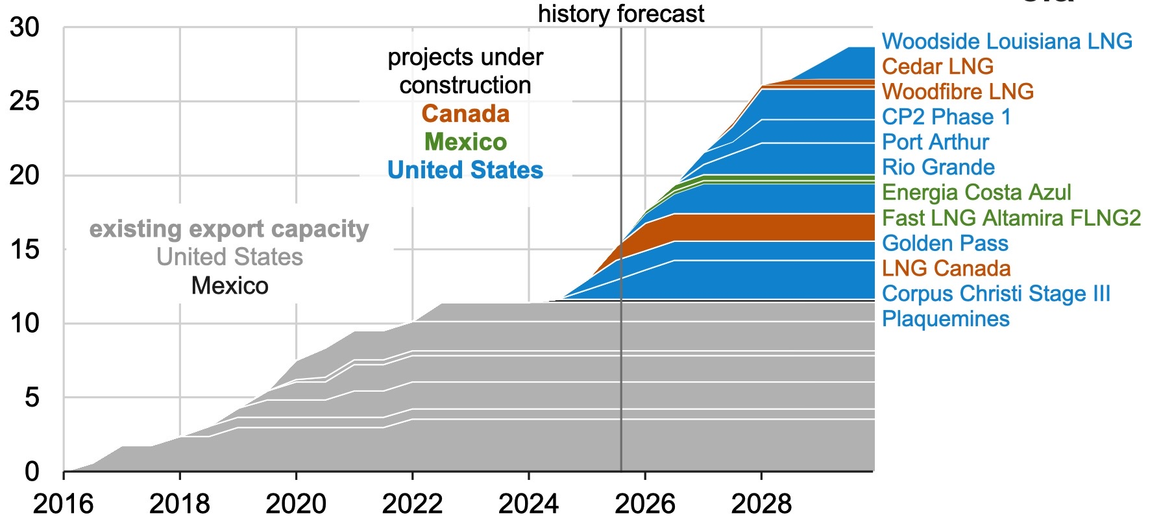
Today, The US Isn’t Importing LNG.
Instead, It’s The World’s Biggest Exporter!
US LNG exports will hit 18.6 Bcf/d by 2027 & export capacity could reach
~ 28 Bcf/d by 2031
N. American liquefied natural gas export capacity
by project, in Bcf/d, 2016 to 2029
Source: EIA. https://www.eia.gov/todayinenergy/detail.php?id=66384 , https://www.eia.gov/todayinenergy/detail.php?id=67224
© Robert Bryce

Slide 13
Where’s That Energy Transition?
Global hydrocarbon use is 29x larger than solar + wind combined. In 2025, hydrocarbon consumption grew 1.5x faster than solar + wind combined (4.6 EJ vs 3 EJ)
Global primary energy use, in EJ, 2025
Source: Statistical Review of World Energy 2026
© Robert Bryce

Slide 14
Global Energy Use, 2025
35
Solar+wind provide just 2.9% (18 EJ) of global energy
16
31
151
201
Hydrocarbons provided 86.2% of global energy in 2025
166
Global energy use, by type, in EJ, and %, 2025
Source: Statistial Review of World Energy 2026
© Robert Bryce

Slide 15
Since 2010, Natural Gas Has Grown Faster Than Any Other Type Of Primary Energy
From 2010 to 2025, global energy use grew by ~ 110 EJ. Gas accounted for 34% of that increase. Furthermore, gas use grew 2x faster than solar and wind combined!
Change in global energy use, in EJ, 2010 to 2025
Sources:: EI Statistical Review of World Energy 2026
© Robert Bryce
Notes:
Why 2010?
1. I published Power Hungry, in which I predicted nat gas was a fuel of the future and promoted N2N.
2. COP16 in Cancún (December 2010) produced the “Cancún Agreements,” which for the first time anchored the 2 °C goal in a UN text, set up a Green Climate Fund, and formalized voluntary mitigation pledges from major emitters including the U.S., EU, China, and India.
3. It was the year of the Macondo well accident, which began a crackdown on offshore drilling.

Slide 16
Under Xi, Gas Has Been China’s Untold Energy Growth Story
9.5
Oil
9
In 2025, China’s gas production was ~ 2.3x larger than solar, & 2.4x larger than wind!
Gas
5.3
Hydro
5
4.2
Nuclear
Wind
4
Solar
Change in China’s domestic energy production, (excl. coal), in EJ, 2010 to 2025
Source: Statistical Review of World Energy 2026
© Robert Bryce

Slide 17
But Coal Is Still King In China
Coal
94.7
69.7
Since 2010, China’s domestic coal production has grown by 25 EJ. That’s 5x faster than its solar production growth
Solar
Nat Gas
9.5
4.2
Change in China’s domestic energy production, Including coal, in EJ, 2010 to 2025
Source: Statistical Review of World Energy 2025
© Robert Bryce

Slide 18

● It's hard to overstate how important energy is to the future here...Eventually the cost of intelligence, the cost of AI, will converge to the cost of energy and it'll be how much you can have. The abundance of it will be limited by the abundance of energy.
— OpenAI CEO Sam Altman, to US Senate Commerce, Science, and Transportation Committee, 8 May 2025
AI Is An Electricity Story
Source: https://www.techpolicy.press/transcript-sam-altman-testifies-at-us-senate-hearing-on-ai-competitiveness/
© Robert Bryce

Slide 19






Data Centers Dwarf All
Other Customer Classes
OpenAI’s Stargate project in Abilene will require 600x more power than an average Costco. Meta’s project in Louisiana will require 2,500x more.
Gigafactory
Peak electricity demand, various building types, in kW
Sources: MISO, https://cdn.misoenergy.org/20241218%20Medium%20and%20Long%20Term%20Forecast%20Workshop%20Presentation667265.pdf, 15., https://www.cnbc.com/2026/07/13/meta-louisiana-data-center-investment-reaches-50-billion-amid-ai-push.html , https://finance.yahoo.com/news/oracle-openai-drop-plans-mega-104331148.html
© Robert Bryce

Slide 20
GOOG’s Electricity Use Is
Doubling Every Three Years!
In 2025 alone, GOOG’s electricity use jumped 35.1%. The company now uses more electricity than New Mexico, a state with 2.1M people
Electricity use per year, in TWh, 2011 to 2025
Source: https://www.gstatic.com/gumdrop/sustainability/google-2024-environmental-report.pdf , https://www.gstatic.com/gumdrop/sustainability/google-2019-environmental-report.pdf, https://www.gstatic.com/gumdrop/sustainability/google-2025-environmental-report.pdf
© Robert Bryce

Slide 21
US Is Now Building 79 GW Of
Data Center Capacity
How much is 79 GW?
It’s more than installed capacity of FL, which has 23.7M people.
Plus, 433 GW of DC capacity has been announced.
Summer 2026 generation capacity by state, in GW, and Aterio estimate
Sources: Aterio,, Oct. 2026, EIA, EPM May 2026, https://www.eia.gov/electricity/monthly/epm_table_grapher.php?t=table_6_02_a
https://worldpopulationreview.com/states/florida
© Robert Bryce

Slide 22


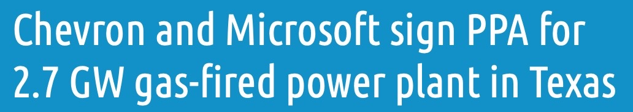
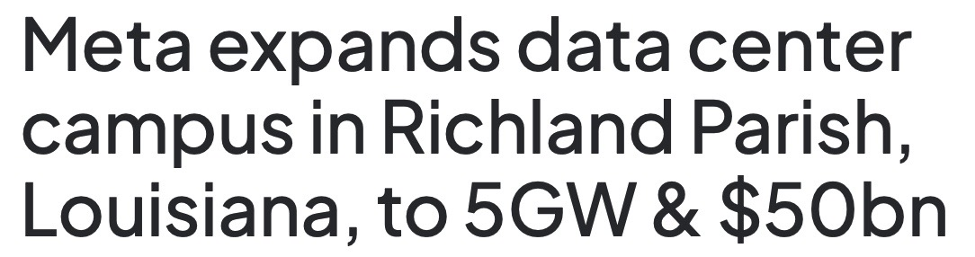

AI Is A Gas Story
August: 9.2 GW
Since April, hyperscalers have announced 25.4 GW of gas-fired capacity
August: 7.6 GW
July: 2.7 GW
July: 5 GW
April: 933 MW
© Robert Bryce

Slide 23
The US Is A Gas Superpower
The US produces ~ 26% of all the natural gas on the planet. It produces more than Canada, China, Iran, Norway, Qatar, & Saudi Arabia combined.
2025 gas production, Bcf/d (US, TX, & Permian figures are for 2026)
Sources: Statistical Review of World Energy 2025, EIA, https://www.eia.gov/todayinenergy/detail.php?id=67364, https://www.eia.gov/outlooks/steo/tables/pdf/5atab.pdf , https://www.eia.gov/todayinenergy/detail.php?id=67944 , Dallas Fed, June 1, 2026, https://www.dallasfed.org/-/media/Documents/research/energy/energycharts.pdf#page=35
© Robert Bryce

Slide 24
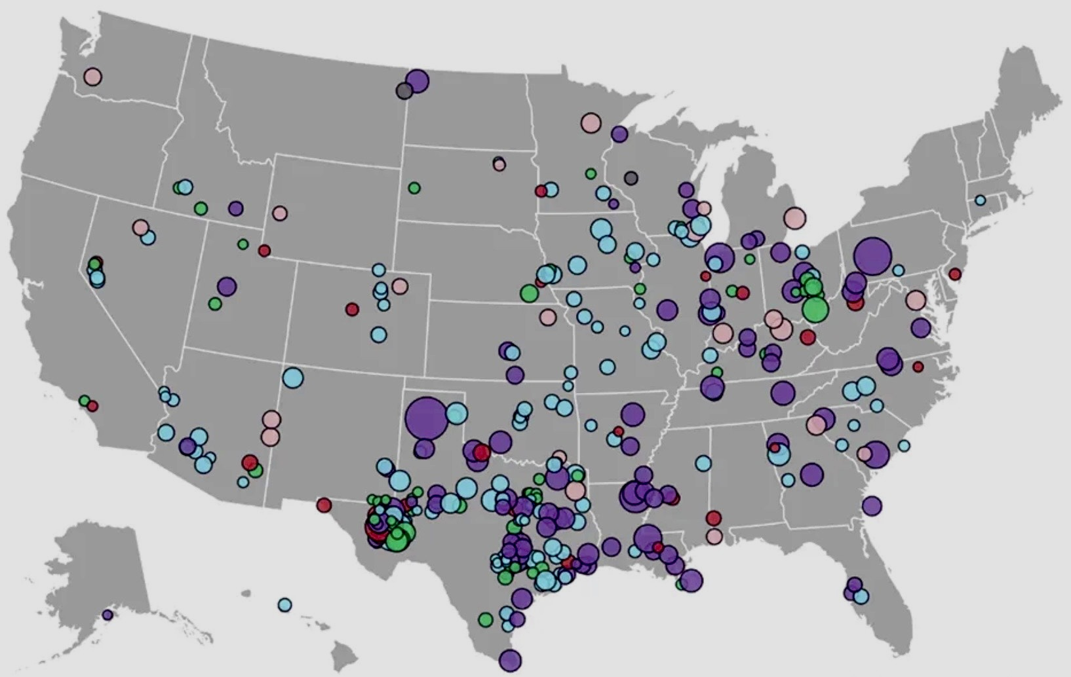
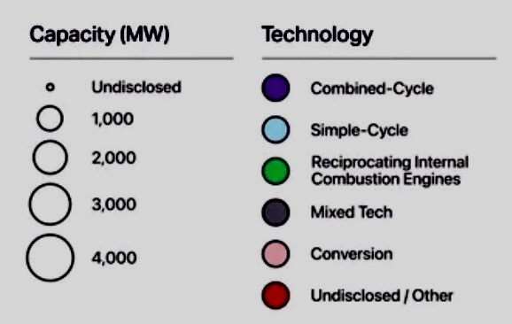
Planned Gas-Fired Capacity In US:
505 Plants Totaling 286 GW!
Planned US gas plants by capacity and type, September 2026
Source: Halcyon. Io, https://halcyon.io/gas-power-plant-tracker
© Robert Bryce

Slide 25
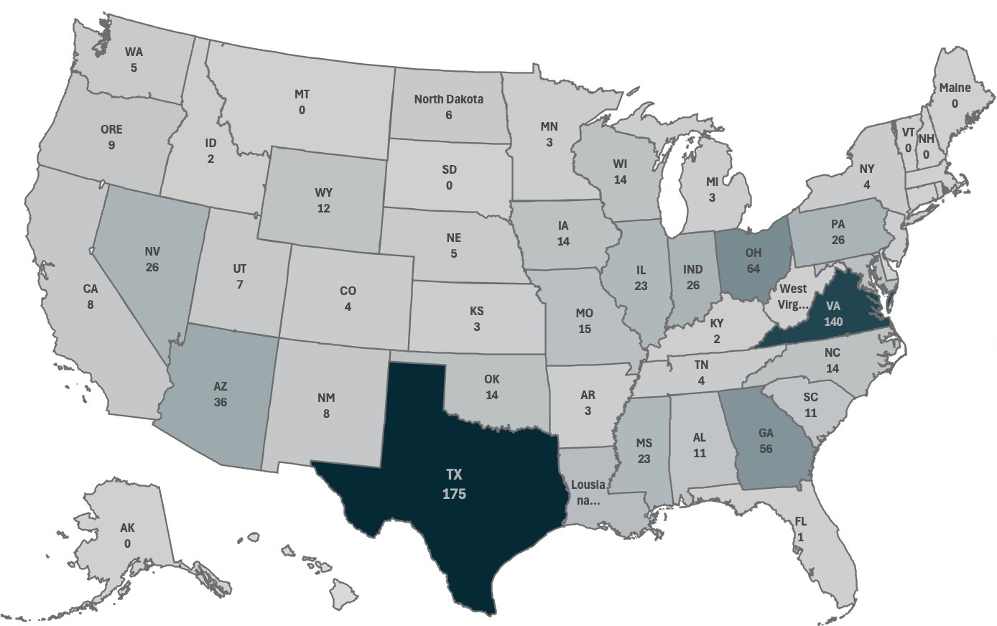
Just 7 States Account For 64% Of
Data Centers Under Construction
26
26
64
140
36
56
175
US data centers under construction, September 2026
Source: Aterio, https://www.aterio.io/insights/us-data-centers
© Robert Bryce
Notes:
769 DCs are under construction

Slide 26
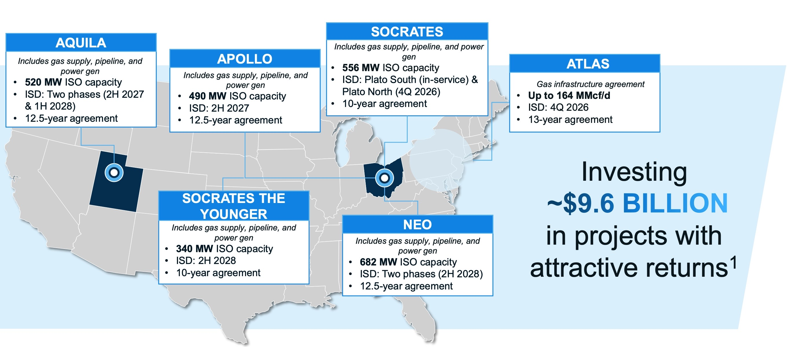

Pipeline Companies Are Becoming Gas-To-Power Companies
Williams 2nd quarter 2026 earnings call, August 1, 2026
Source: Williams https://investor.williams.com/static-files/f614f046-cccf-4f74-91e9-5202008eeafc , 30.
© Robert Bryce

Slide 27
AI Is A Gas Story, Part 2
US data center capacity, operating & under construction, vs.
capacity of planned & operating nat gas plants, in GW, Oct 2026
Sources: Cleanview, Halcyon, Aterio
© Robert Bryce

Slide 28

Since 2001, US Gas-Fired Power Generation Has Nearly Tripled
13.0
5.3
When Enron failed, 16%
(639 TWh) of US electricity came from gas-fired plants.
In 2025, it was 41% (1,807 TWh).
Power burn, Tcf/year, 1997 to 2025
Source: EIA, https://www.eia.gov/dnav/ng/hist/n3045us2A.htm, , https://tinyurl.com/mrxjb7hx
© Robert Bryce
Notes:
43% of US generation came from gas.
https://www.eia.gov/tools/faqs/faq.php?id=427&t=3

Slide 29
Gas Turbine Orders Are Dwarfing The Growth Of SMRs
GEV backlog: ~ 125 GW
SMERY backlog: ~ 95 GW
MHVYF backlog: ~ 30 GW
N. American SMRs: < 1 GW.
0.7
GE Vernova
Siemens
MHI
271
SMRs under construction in N. America vs.
order backlog for gas turbines, in GW, by manufacturer
Sources: Company reports, author estimates for Doosan & CAT
© Robert Bryce

Slide 30
Even ICE Generators Are Dwarfing SMRs
Wait times for gas turbines can be up to 4 years. Rather than wait, data center owners are turning to large Otto-cycle engines for BTM power.
0.7
8.4
SMRs under construction in N. America vs.
order backlog for ICE engines for data centers, in GW, by manufacturer
Sources: Company reports, news media.
© Robert Bryce

Slide 31
N2N: Natural Gas To Nuclear
Why Natural Gas?
  ● It’s affordable & dispatchable
  ● CH₄ resources are super abundant & widely distributed
  ● Low political risk, can be burned in turbines & ICEs
  ● Gas-fired generation in developing world is miniscule
  ● Gas pipeline & storage network is huge
© Robert Bryce

Slide 32
Since The Start Of The Iran War, Natural Gas Prices In The US Have Been Flat. But In Europe (TTF) and Asia (JKM) They’ve Soared.
JKM is up 143%.
TTF is up 147%.
HH is up 8%.
JKM
$25.70
TTF
$24.75
$10.60
$10.01
Henry Hub
$3.04
$2.82
Front-month nat gas spot prices, $/MMBtu, Feb. 25 to Oct. 5, 2026
Source: CME Group
© Robert Bryce

Slide 33
Why Nuclear?
  ● Needs 2,000x less land than wind, 200x less than solar
  ● Low material intensity, high EROEI
  ● Energy security & grid stability
  ● Price hedge against hydrocarbons
  ● Challenges: NRC, NGOs, political risk, fuel
© Robert Bryce

Slide 34
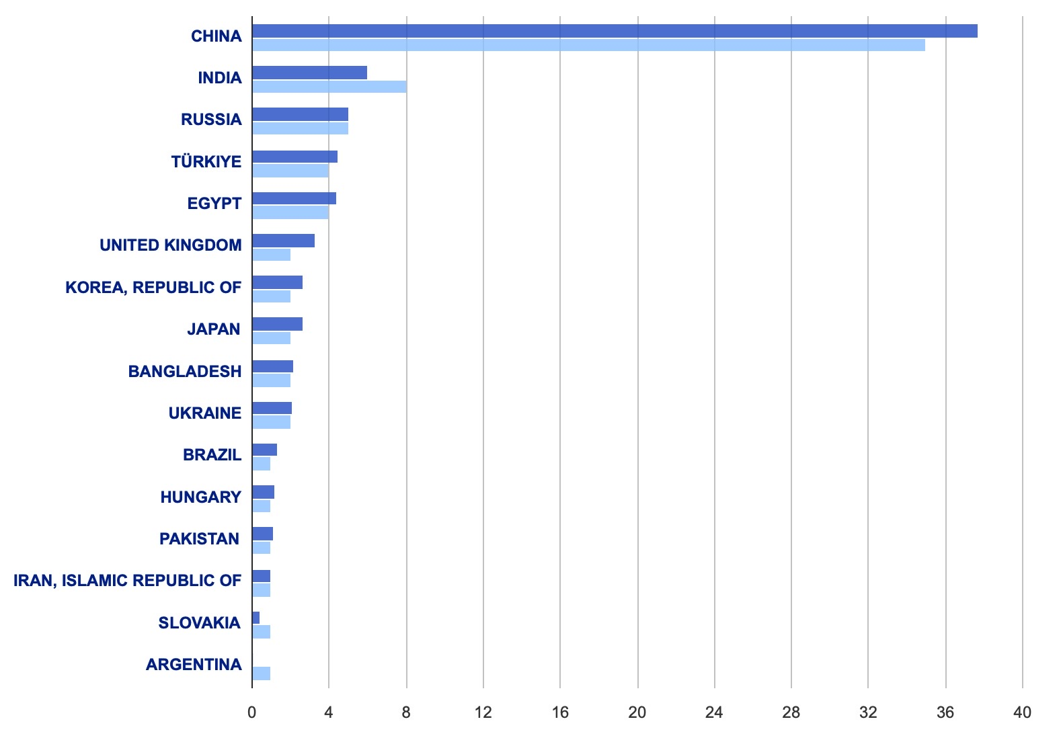

Nuclear Won’t Power AI Anytime Soon
China is building 37.7 GW. That’s 50% of the global total! Where’s the US? Canada?
Reactors under construction, by country, April 2026
Sources: IAEA, https://pris.iaea.org/pris/worldstatistics/underconstructionreactorsbycountry.aspx, data as of 041226
© Robert Bryce

Slide 35
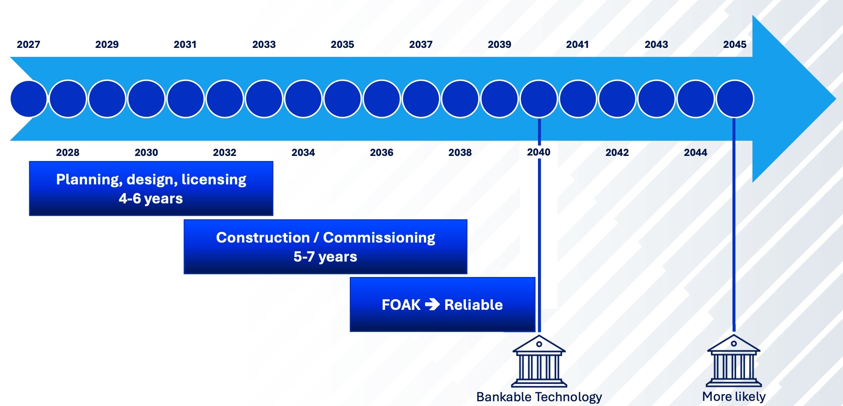
Timeline To Bankable Projects
© Robert Bryce

Slide 36

It’s All About Cost
60% of the all-in operating cost of new nuclear plants
is the cost of capital (World Nuclear Assoc.)
● Vogtle 3&4 (2 x AP1000) cost: $36.8 billion: $16.5M/MW
● TVA estimates it will spend ~ $5.4 billion on a GE-Hitachi BWRX-300 at Clinch River: $18M/MW
● TerraPower’s 345-MW Natrium reactor in Wyoming will cost ~ $4 billion: $11.6M/MW
Between 2023 and 2025, the cost of building new gas plants increased 66%. The average project expense rose to $2,157 per kW: $2.2M/MW
Sources: WNA, https://world-nuclear.org/information-library/economic-aspects/economics-of-nuclear-power
OilPrice.com, https://oilprice.com/Alternative-Energy/Nuclear-Power/DOE-Bets-Big-on-Costly-SMRs.html
NY Times, https://www.nytimes.com/2026/03/04/climate/nuclear-power-terrapower-construction-permit.html
Bloomberg, April 2026, https://www.eenews.net/articles/cost-of-building-us-gas-plants-spikes-66-report-says/
© Robert Bryce

Slide 37
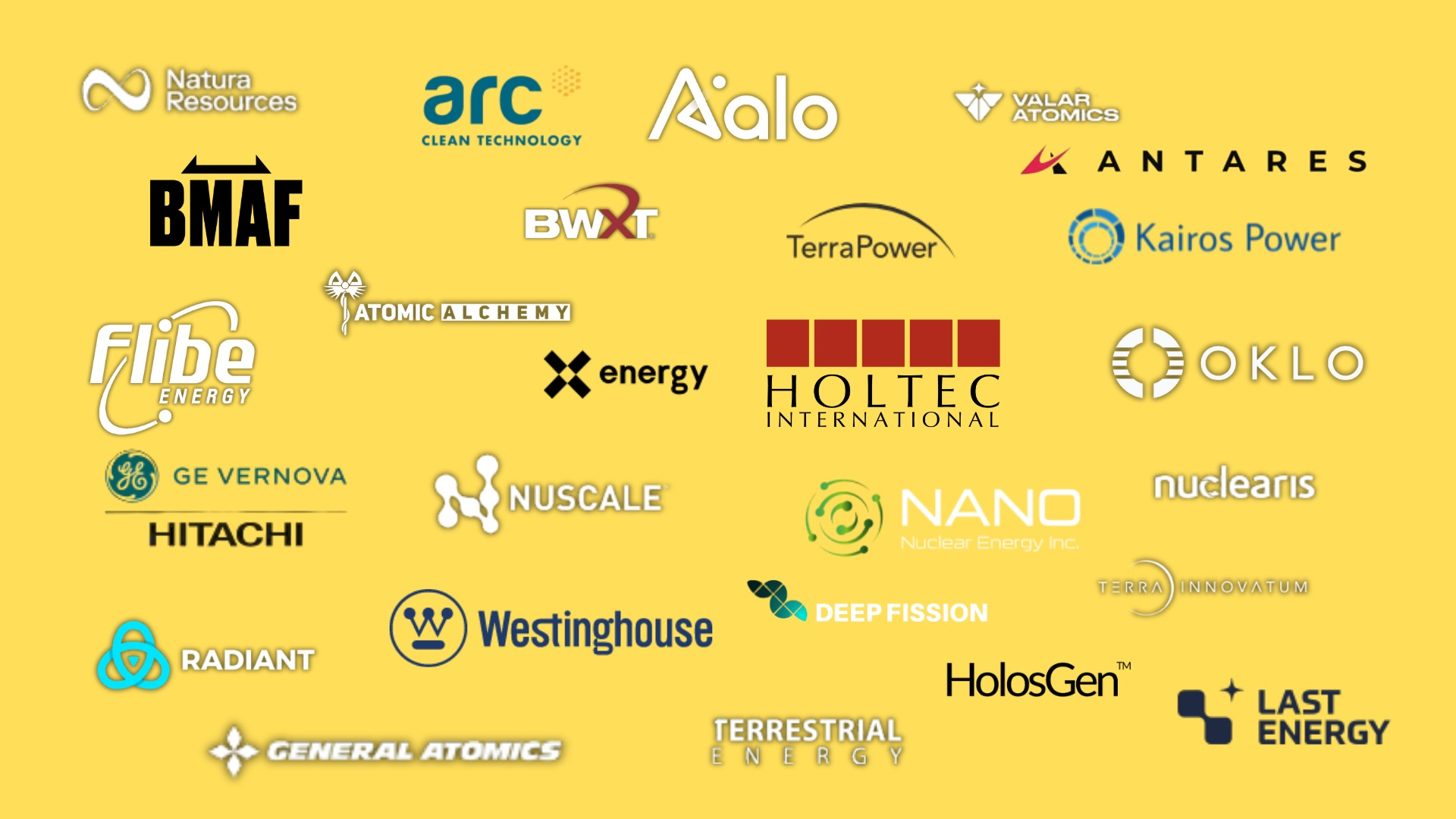
SMR Intelligence US
  ● 42 Companies
  ● 47 Reactors
  ● Market cap of the 8 US-based pure-plays: ~ $19.8B
  ● Market cap of incumbents: > $300B
Source: Robertbryce.substack.com
© Robert Bryce

Slide 38
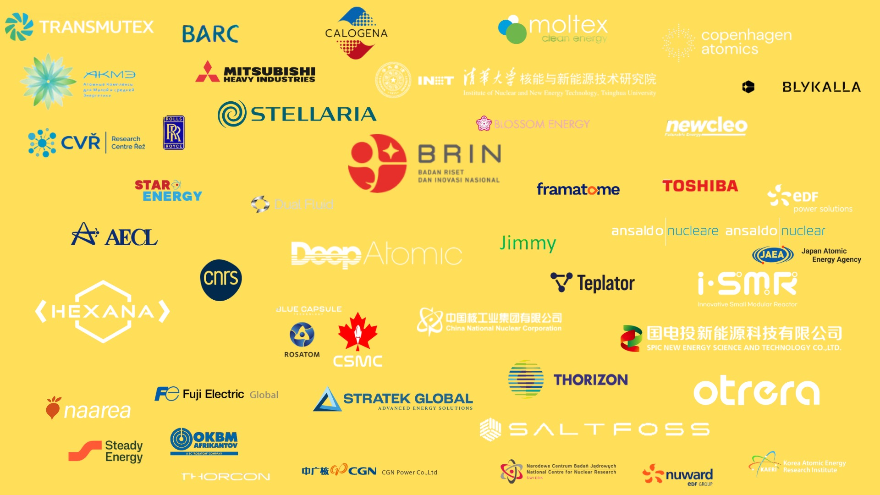
SMR Intelligence Global
  ● Non-US
  ● 19 Countries
  ● 56 Entities
  ● 73 Reactors
  ● Total w/US:
  ● 97 entities
  ● 120 designs
Sources: Robertbryce.substack.com
© Robert Bryce

Slide 39
US Nuclear Depends On Foreign Fuel
Production Of Uranium Oxide vs. Imports, 1949 to 2024
Imports accounted for 99% of the U₃O₈ used in 2023 to make nuclear fuel.
— EIA, Jan. 30, 2025
Million Pounds
Source: EIA, EPM , https://www.eia.gov/totalenergy/data/monthly/pdf/mer.pdf Table 8.2, https://www.eia.gov/todayinenergy/detail.php?id=64444
© Robert Bryce
Notes:
New DOE report: China controls 92% of Nd magnet production.

Slide 40
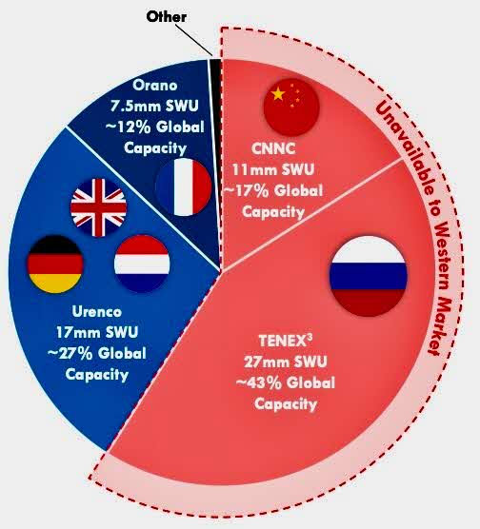

Who Will Supply The U & SWU?
Current global capacity of ~ 60 million SWU is insufficient to meet total LEU and HALEU needs in 2050 (81 million to 137 million SWU) as the global nuclear fleet grows.
— Breakthrough Institute, 2025
Sources: Centrus Energy, https://investors.centrusenergy.com/static-files/058b474a-c135-4600-a84b-e9908864a7af Breakthrough Institute, https://thebreakthrough.imgix.net/pdfs/Nuclear-Fuel-and-Enrichment-Diversification_v6.pdf
© Robert Bryce
Notes:
60% Of Global Production Is Controlled By Russia And China.

Slide 41
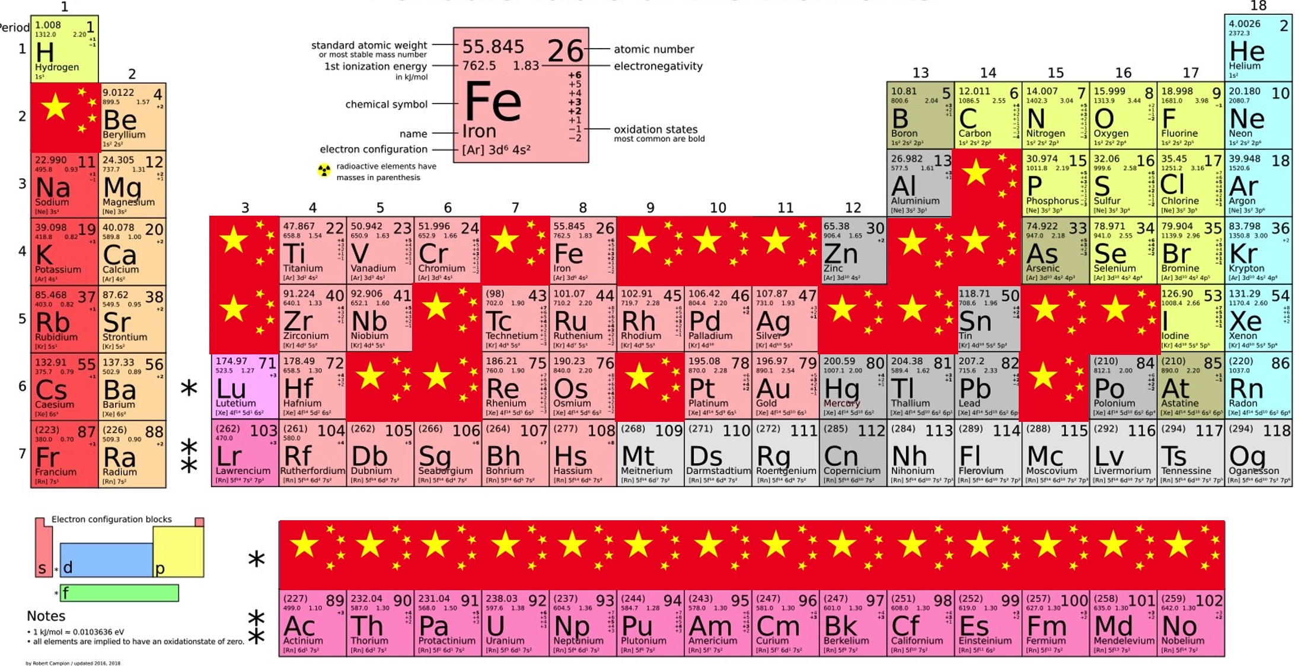
China Has A Stranglehold On 33 Strategic Elements, Including All Of The REEs
Source: IEA, author
© Robert Bryce
Notes:
China’s stranglehold on REEs will affect the nuclear industry:
dysprosium, europium, gadolinium, holmium, samarium and yttrium are are all used in nuclear reactors.

Slide 42
Top Issues For US
Energy & Power Sectors
● Surging gas & power demand (LNG &AI)
● Inflation, labor, & supply chains (China & Russia)
● Permitting & land-use conflicts
● New nuclear: How soon? How much?
● Hydrocarbons are here to stay!
© Robert Bryce
Notes:
Reliability and affordability go hand in hand
Who will turn the wrenches?

Slide 43




YouTube.com/@RobertBryce

Slide 44


JuiceTheMovie.com
JuiceTheSeries.com
© Robert Bryce

Slide 45






© Robert Bryce

Slide 46

Thank you

