Slide 1

U.S. natural gas globalization risk or benefit to Florida prices?

Slide 2
fundamentals

Slide 3
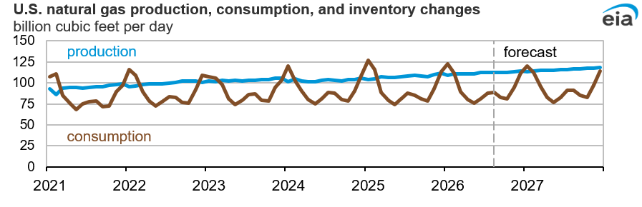
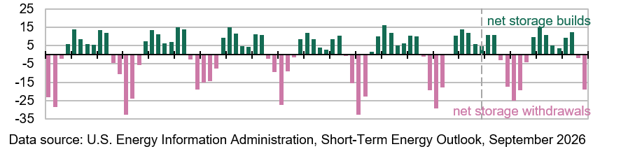
Natural gas…the basics aren’t so basic

Slide 4
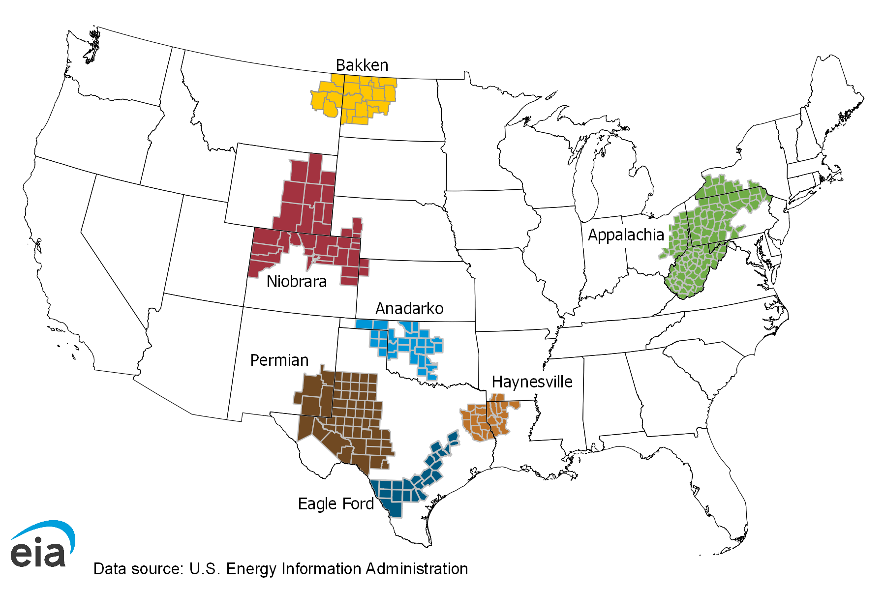
Not all natural gas is created equally…which is good

Slide 5
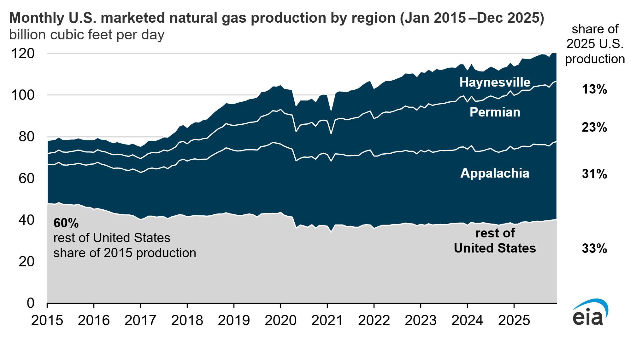
U.S. Natural gas supply…the importance of location
67%
40%

Slide 6

u.s.
Demand
Total consumption is
~ 83 bcf/day
45% increase last 25 years
~36 bcf/d
Power
Source: EIA

Slide 7
Florida
Demand
~4 bcf/d
Power
Total consumption is
~ 4.5 bcf/day
200% increase in last 25 years
11% of U.S. natural gas power is in Florida
Source: EIA

Slide 8
  Natural Gas: 75%
  Nuclear: 15%
  Coal: 5%
  Solar: 3%
  Other: 2%
Second largest producer of power in U.S.
Source: EIA

Slide 9
Florida 87%
US 43%
U.S. bumps up with low prices…
Florida stays constant
Source: EIA

Slide 10
U.S. share of global natural gas demand…increasing
 | Demand bcf/day
Year | Florida | U.S. | Global | FL share of U.S. | US share of Global
2030 forecast | 4.7 | 125 | 435 | 3.8% | 28.7%
2025 | 4.5 | 92 | 403 | 4.9% | 22.8%
2020 | 4.3 | 84 | 370 | 5.1% | 22.7%
2015 | 3.7 | 72 | 340 | 5.1% | 21.2%
2010 | 3.2 | 65 | 310 | 4.9% | 21.0%
Source: EIA

Slide 11
The U.s. → Global natural gas connection
The importance of LNG

Slide 12
Imports and exports of natural gas
Year | 2023 | 2024 | 2025 | 2026 | 2027
Pipeline imports | 8.0 | 8.5 | 8.6 | 8.1 | 8.0
LNG imports | 0.0 | 0.0 | 0.0 | 0.1 | 0.1
Pipeline exports | -9.0 | -9.1 | -9.5 | -10.1 | -10.5
LNG exports | -11.9 | -11.9 | -15.1 | -17.4 | -18.6
Net import/export | -12.8 | -12.5 | -15.9 | -19.3 | -21.1
Data source: U.S. Energy Information Administration, Short-Term Energy Outlook, September 2026

Slide 13

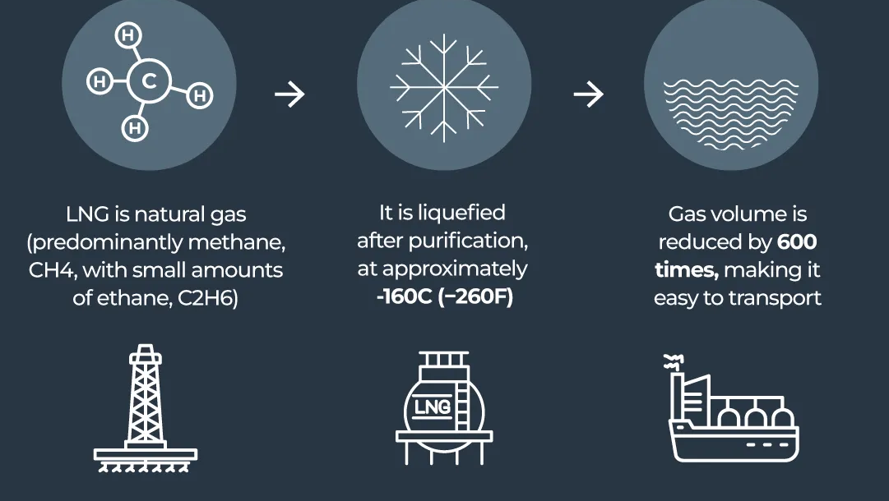
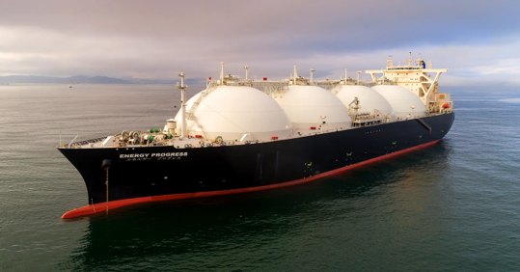
What Is Lng?
Bridging the Domestic Market to the World

Slide 14
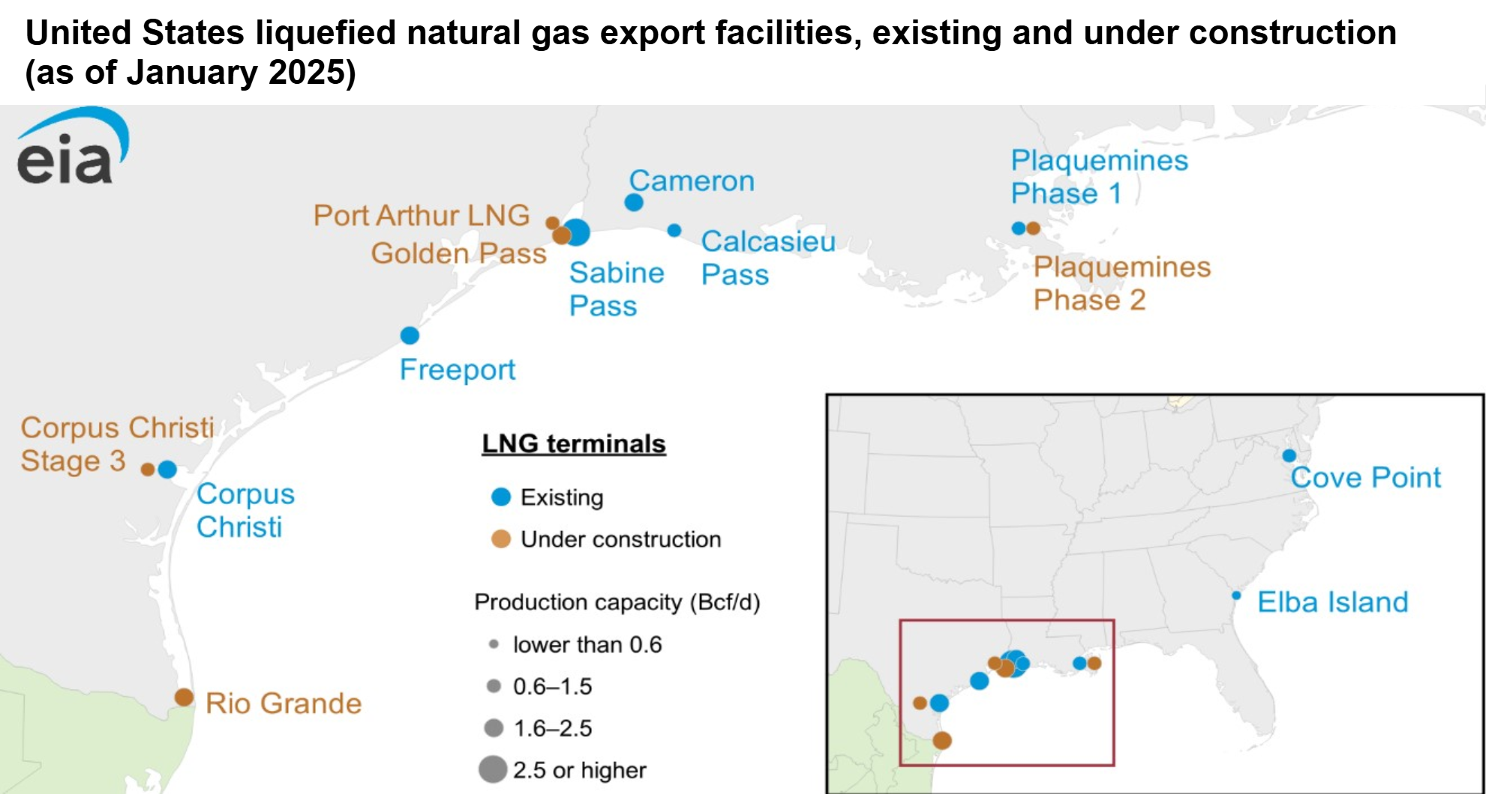
Where are the lng export facilities and why there?

Slide 15
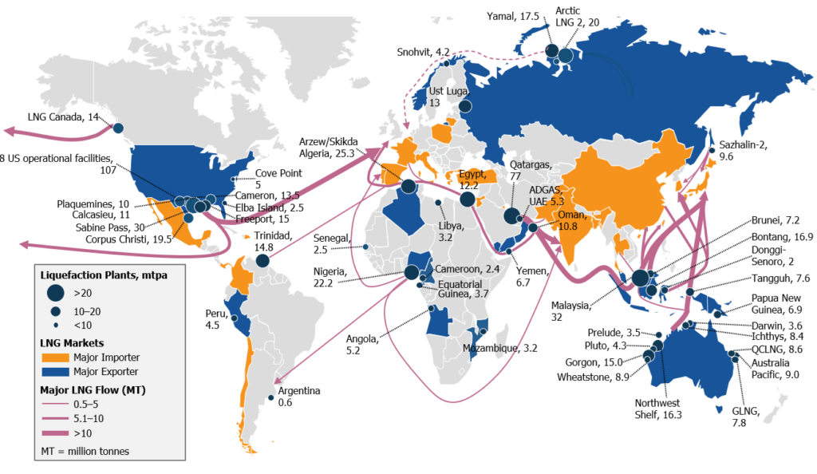
Where does the lng go?
Europe – 45%
Asia – 30%
Other – 25%
Source: EIA

Slide 16
U.S. Dominates
LNG export and growth

Slide 17
U.s. natural gas demand with LNG
~18 bcf/d
LNG (2026)
Total consumption is
~110 bcf/day
75% increase in last 25 years
Source: EIA

Slide 18
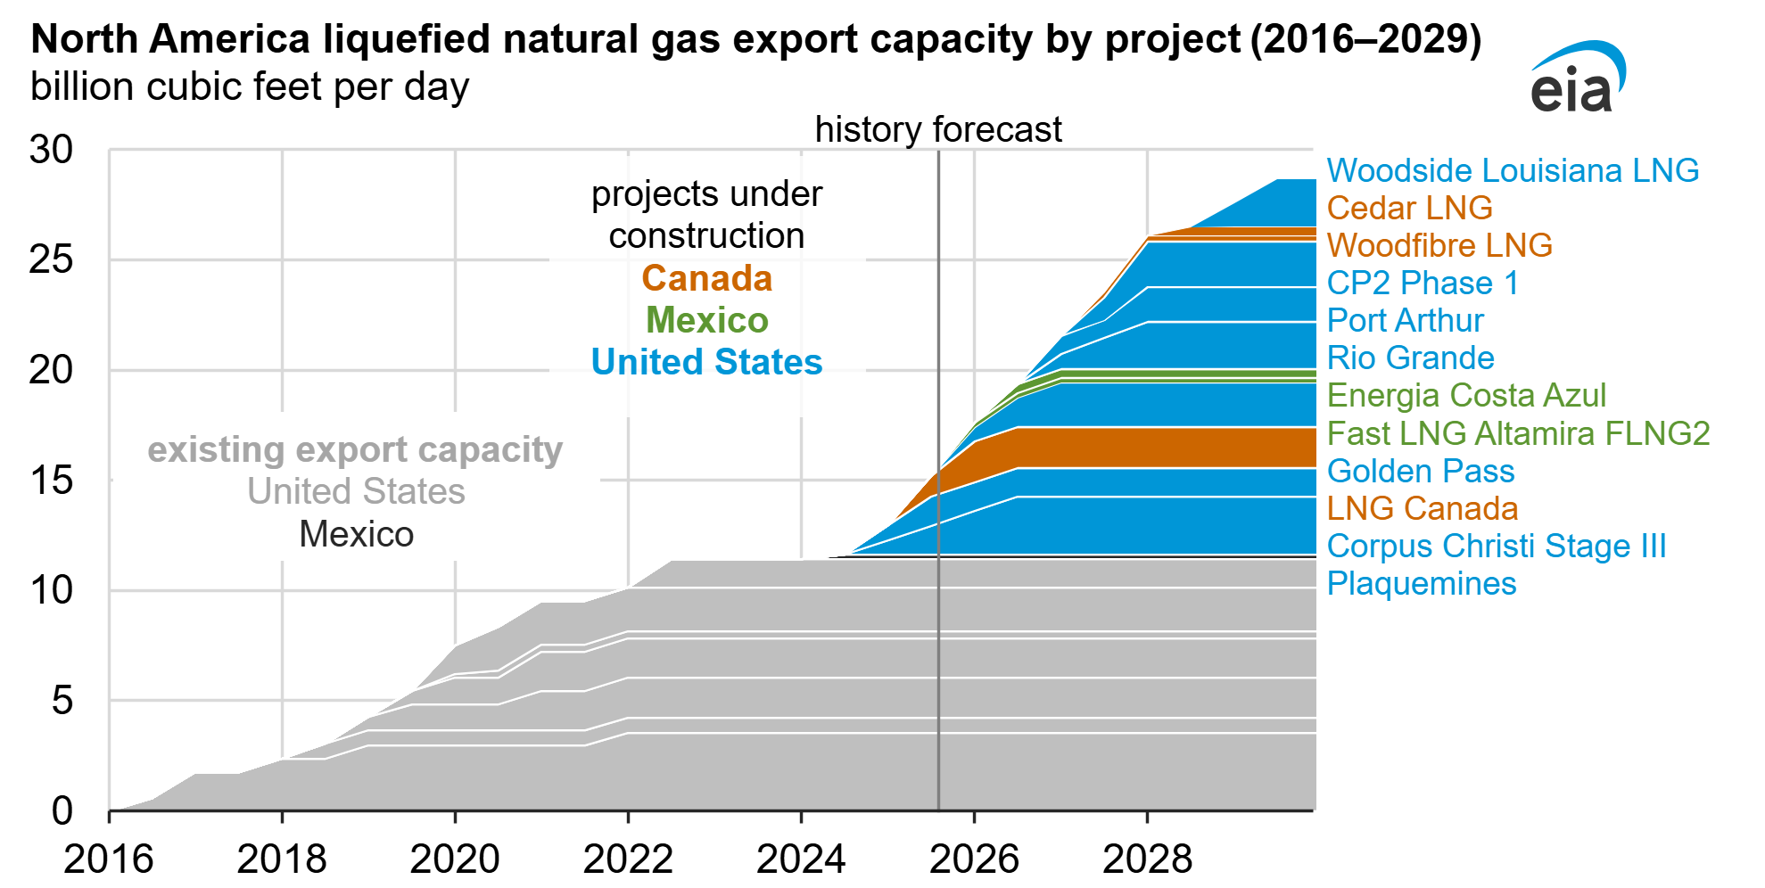
LNG forecasted growth continues…happens quick
From 0 to 4 bcf/day in less than 12 months
Current Florida NG Demand
+22 Bcf/d forecasted additional demand by 2036
Source: EIA

Slide 19
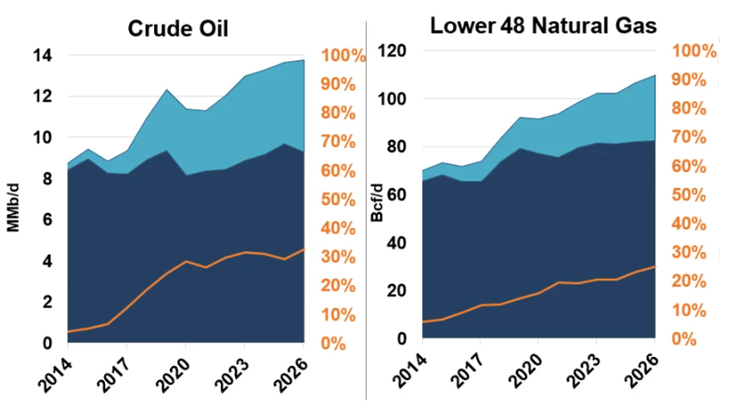
So…
is it to much for export?
Crude: ~30%
Nat gas: ~26%
Either way…the u.s. is, and will be, extraordinarily connected to the world for natural gas
Source: RBN Energy, EIA

Slide 20
Global events… impact on U.s. and Florida natural gas prices

Slide 21
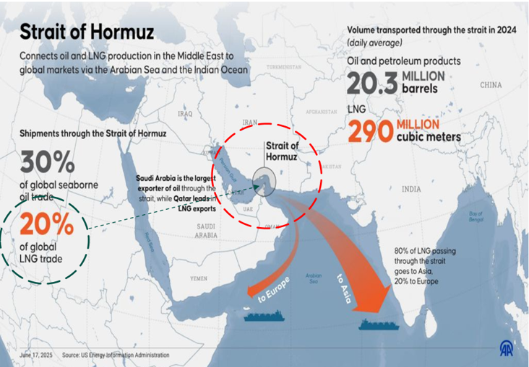
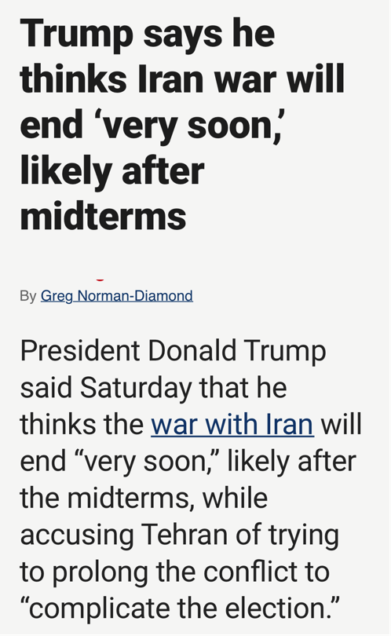
US / Iran war global crude & LNG disruption
What has happened?
Strait of Hormuz blocked
Some reduced demand
Oil reserves tapped
Some Increased lng production

Slide 22

Natural gas price scenarios
Higher LNG prices create higher long-term and winter price risk
Higher Texas oil prices can cause lower US natural gas prices
Higher Pacific Ocean sea temps should cause lower US gas prices

Slide 23
current: 70%
5 yr norm: 87% winter mandate: 90%
New EU target: 80%
Expected winter: 75%
source of supply
LNG: 50%
Pipeline: 50%

Slide 24
Why does it go there?
Global Lng prices are volatile and higher than U.S.
Ukraine
Iran
Covid

Slide 25
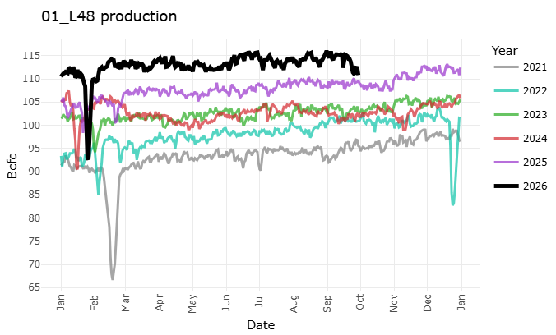
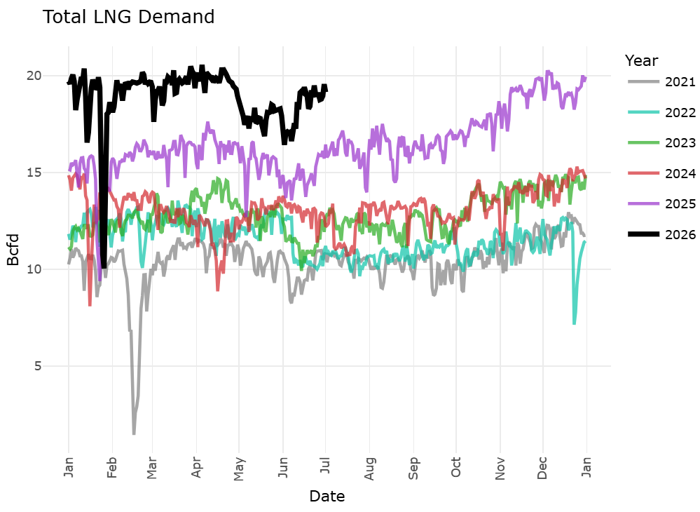
Lost production means…outbidding global LNG Prices
Fern
Fern
Elliott
Elliott
Elliott
Uri
Uri
Uri
Freeze offs cause serious production losses
LNG demand can be cut…but at a price
~50% of production loss displaced
Expect Henry Hub +$1 for +$10 of global LNG

Slide 26
Natural gas price scenarios
Higher LNG prices create higher long-term and winter price risk
Higher Texas oil prices can cause lower US natural gas prices
Higher Pacific Ocean sea temps should cause lower US gas prices

Slide 27
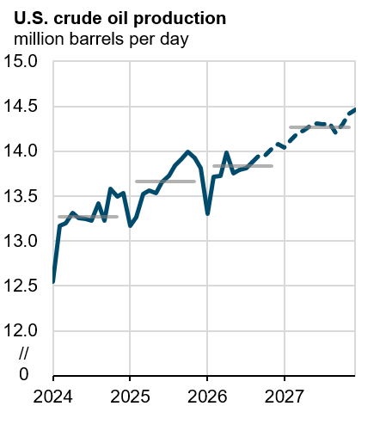
Crude oil production on the rise…
higher prices for longer?
Source: EIA

Slide 28
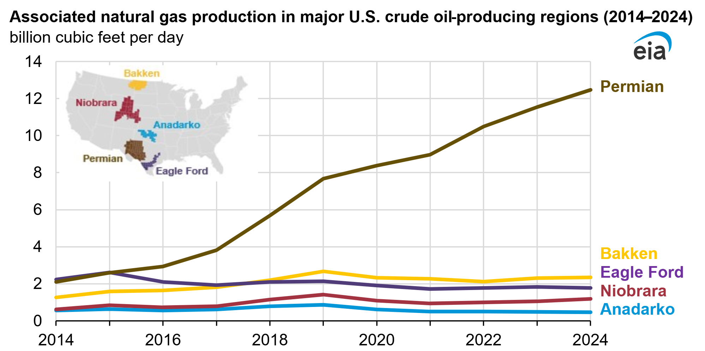
The Permian has the most oil (6.5Mmbl/day)… and the most associated gas (14 bcf/day 2026)
Associated Gas

Slide 29
Iran war:
natural gas price = inverse reaction to oil price
Iran war start

Slide 30
Post conflict… oil prices forecasted to decrease
…natural gas stronger
WTI Crude
Resolution being priced in?
Henry Hub

Slide 31
Natural gas price scenarios
Higher LNG prices create higher long-term and winter price risk
Higher Texas oil prices can cause lower US natural gas prices
Higher Pacific Ocean sea temps should cause lower US gas prices

Slide 32
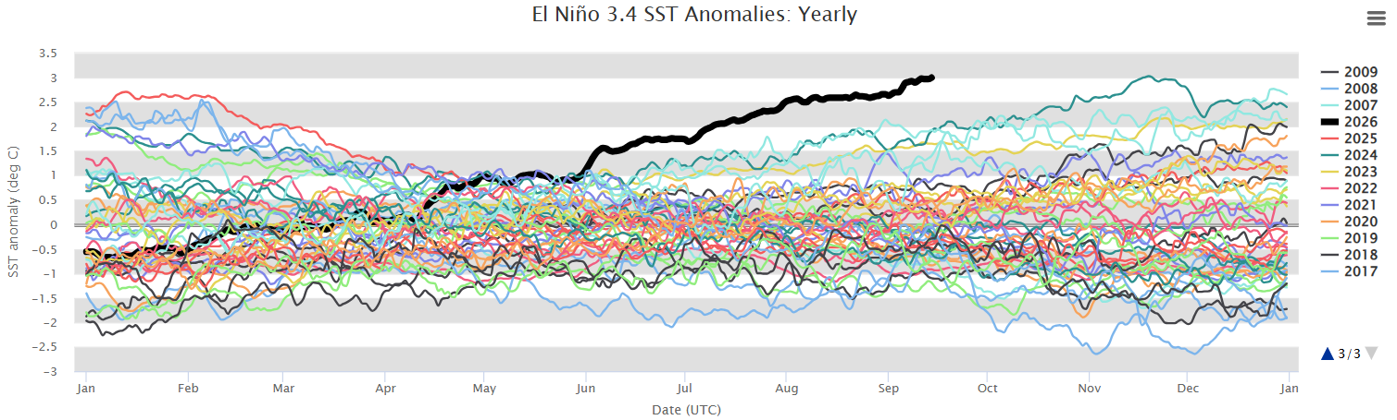
“super” el Nino…what to expect this winter
Source: NOAA

Slide 33
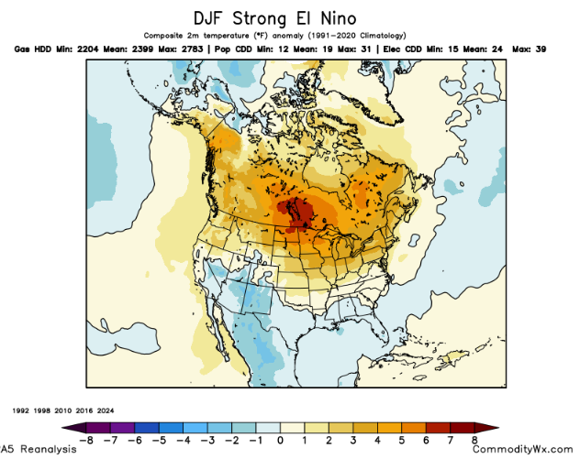
“Analog method”
Long term forecasts are built on past outcomes

Slide 34
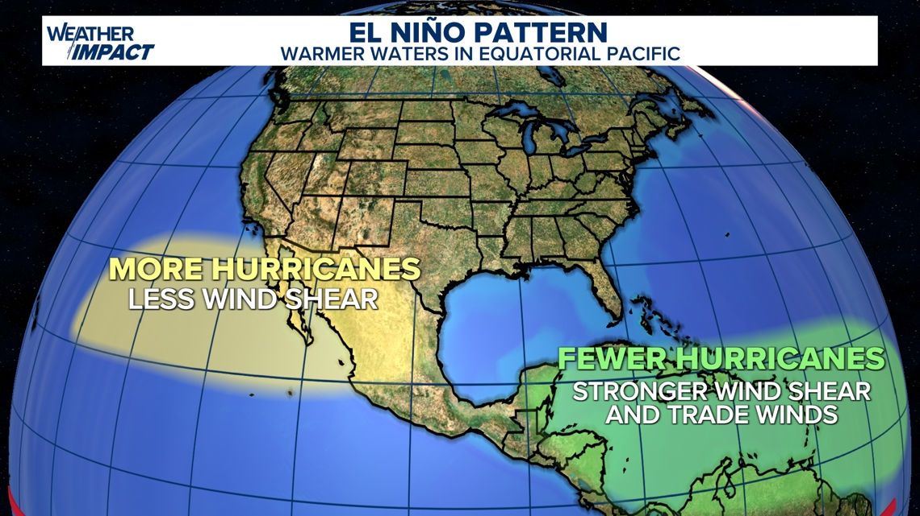
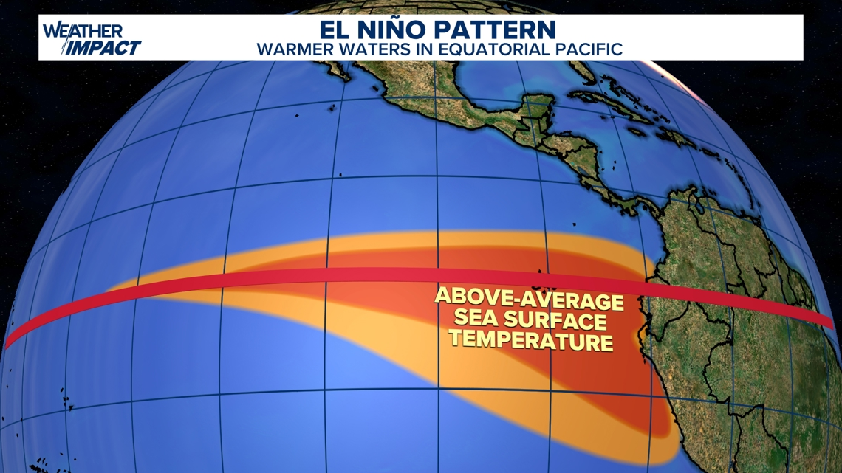
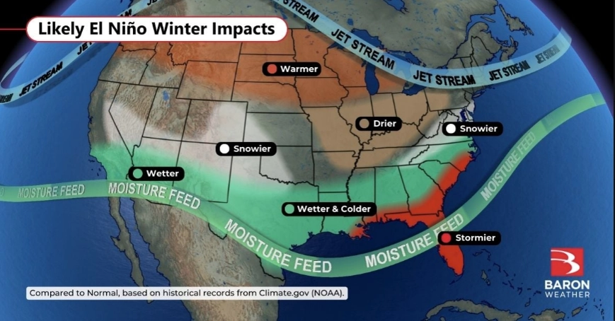
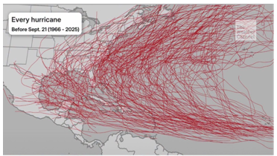
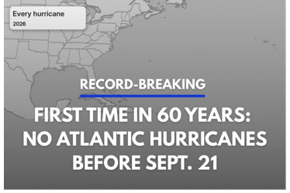
“Super” el Nino Impacts
Forecast based on history
SUMMER OF FEWER HURRICANES
EUROPE → MORE WIND, LOWER TEMPS

Slide 35
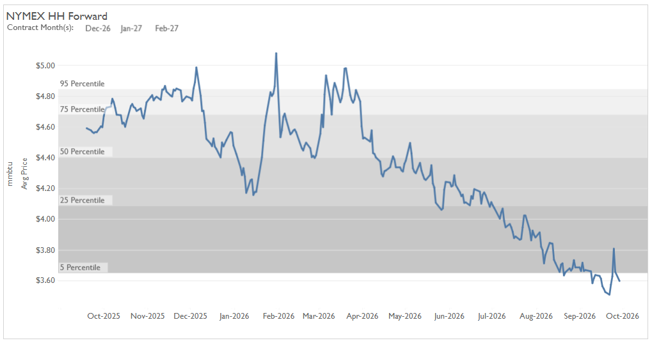
“super” el Nino…what to expect this winter
Winter Prices so far
Winter ’26-’27 has been on downward slide (1)
Prices off 40% since Mar ’26
Potential Outcome
Still risks, but drift lower based on history (2)
Anomalies: W15 2.6C; W23 2.4C; W26 ~3.4-4.1C
1
2

Slide 36
“super” el Nino…Florida expectations
 | National Market (Henry Hub) | Florida Market
Weather Pattern | Warmer northern tier | Cooler, wetter, and stormy
Demand Driver | ~5% less res/comm heating use | Higher electricity burn
Renewables | Normal/high regional solar generation | Suppressed solar → heavy cloud cover
Price Effect | Lower wholesale prices | Elevated fuel consumption on the power grid

Slide 37
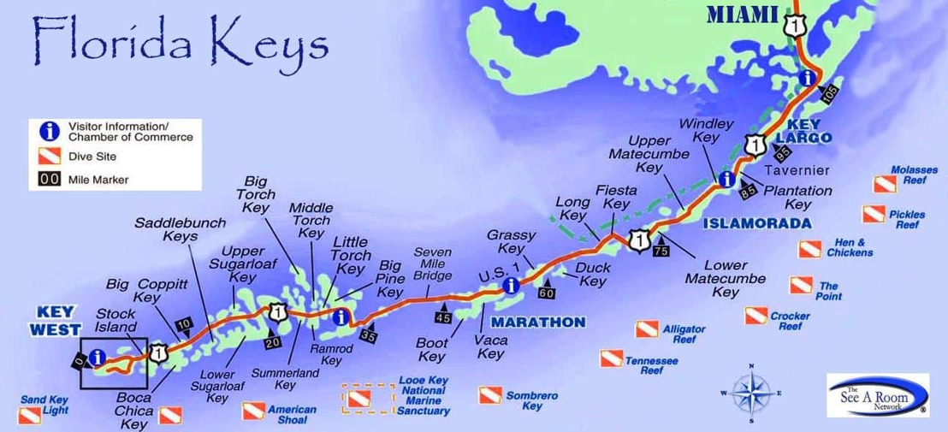
Impact on Florida prices

Slide 38
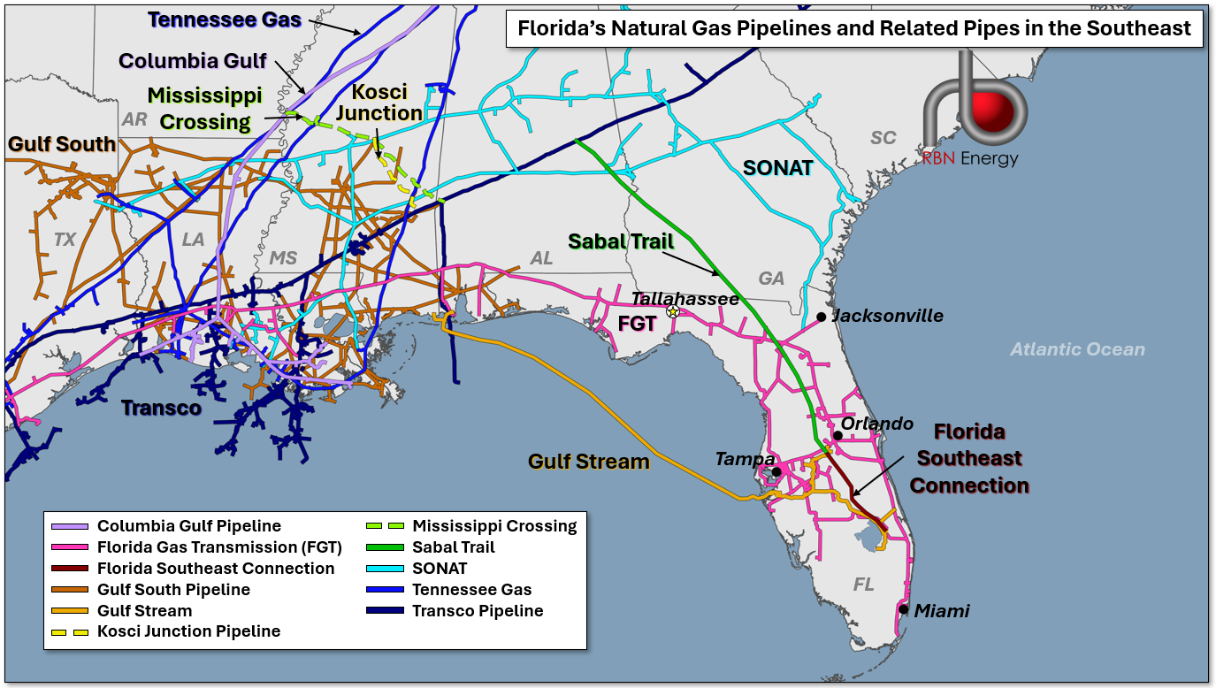
Getting gas to Florida…needs to be a demand “pull”
"The current gas infrastructure is insufficient to meet the demand of the state of Florida for the expanding needs required for residential, commercial, industrial, local distribution companies, and electric power generation customers," FGT said.
Salt Storage
Henry Hub
Source: RBN Energy

Slide 39
New winter low temp vs price paradigm?

Slide 40
Competition for molecules…LNG + SE demand + data centers
LNG Volume Increase
Basis spreads increasing

Slide 41
Flat to lower
What is next
Long term prices are flat to lower →
New growth must be met with pipeline expansions
New Miss. Storage is being planned
Data centers are the next big thing

Slide 42
Risk or benefit?
Increased U.s. NG connection to globe
Oil, Europe and el Nino will unfold
Florida continues to compete for molecules

