Slide 1
Outlook for the U.S., Florida and Natural Gas
Florida Gas Utility
Hank Fishkind
June 8, 2016
Hank Fishkind
Fishkind & Associates, Inc.
12051 Corporate Boulevard
Orlando, Florida 32817

Slide 2
Yogi Berra observed, it’s tough to make predictions, especially about the future

Slide 3
U.S. Forecast Summary 2016 – 2018
2.0% Growth is as good as it gets
  Strong gains in jobs and rising wages
  Low oil prices and low inflation
  Low interest rates even with the increases
  Budget and debt ceiling done till 2018
Monetary policy – the shift to normal rates
Fiscal policy shifts to mildly stimulative
Growth will accelerate a bit in 2016 and slow a bit in 2017-18 as rates rise
Main forecasts risk: (1) Geopolitical risks, (2) weaker global growth, and (3) effects of higher interest rates

Slide 4
Florida Summary
Strong cyclical upswing underway
  Sustained job growth lead by tourism and healthcare
  Population growth stronger then expected
Recovery is accelerating, and it will be above average recovery by Florida standards by 2018
  375,000 population growth
  150,000 new jobs
  180,000 housing starts
Geographic focus of growth shifted and tightened

Slide 5
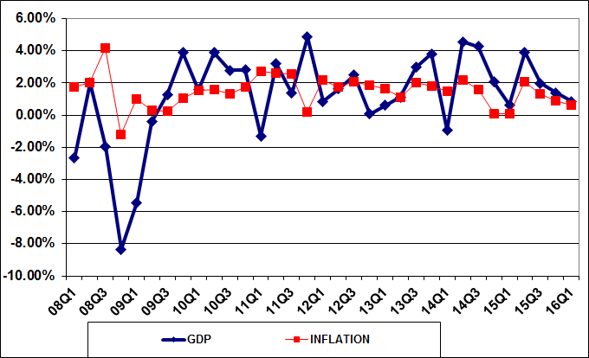
RECENT TRENDS IN GDP AND INFLATION

Slide 6
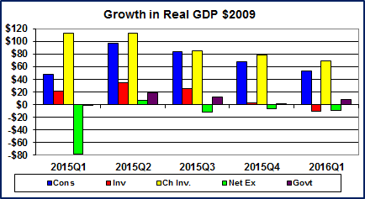

Slide 7
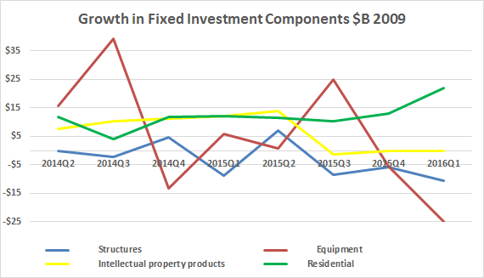

Slide 8
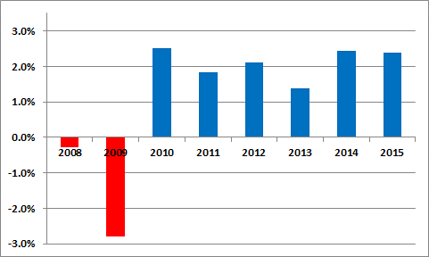
Low Growth Trajectory for
Real GDP Unlikely to Change
Fallout from Great Recession
  Increased regulation
  Lower risk tolerance
Globalization
  Holds down prices
  Holds down wages
Income Inequality
Underestimate GDP
  Investment in Tech
  Consumption Social Media
Current mix of monetary and fiscal
Policies will yield +/- 2% Growth GDP

Slide 9
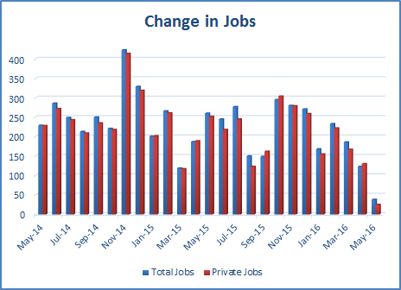

Slide 12
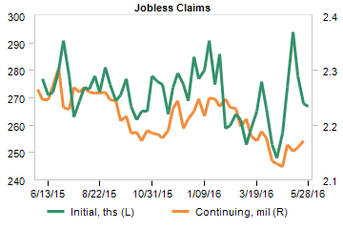

Slide 13
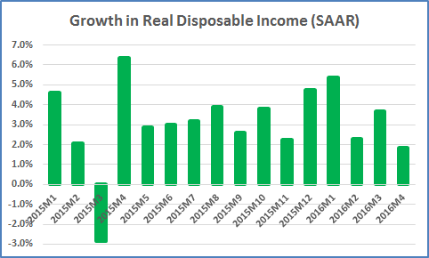

Slide 14
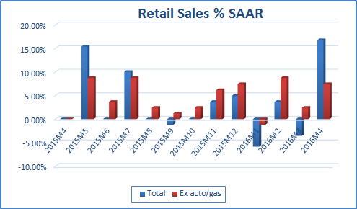

Slide 15
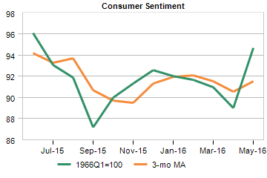

Slide 16
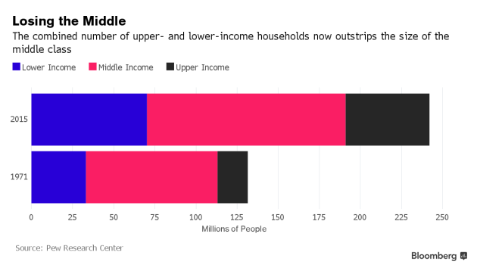

Slide 17
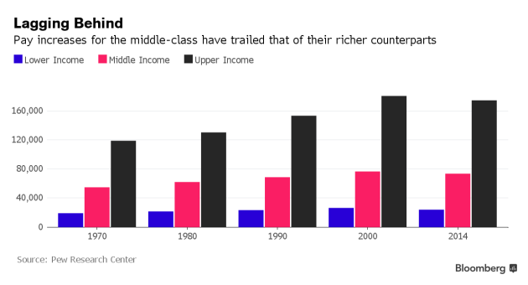

Slide 18
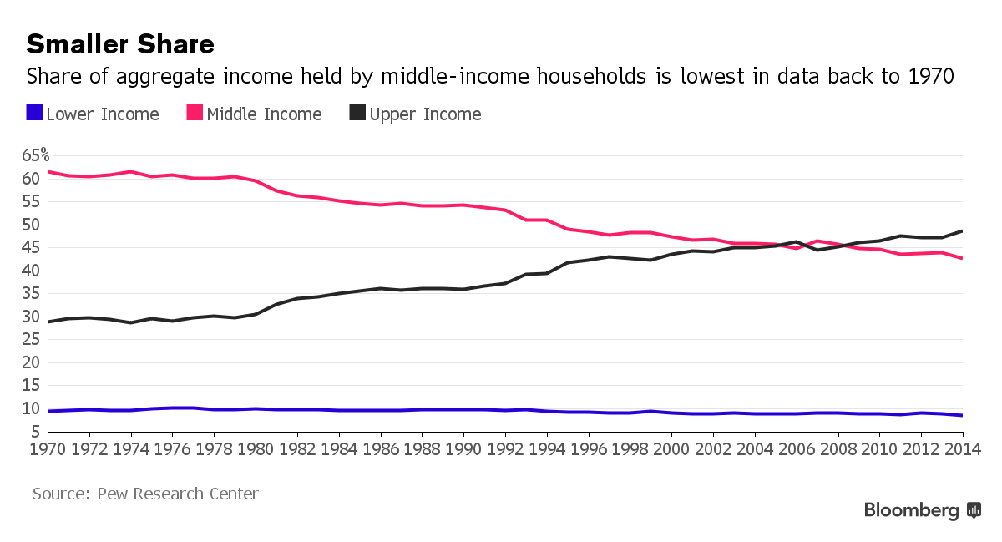

Slide 19
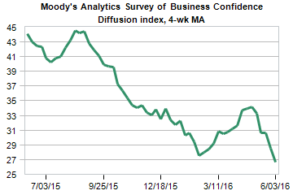
Global Business Confidence
South America very weak
U.S. fair but not as good as earlier in the year

Slide 20
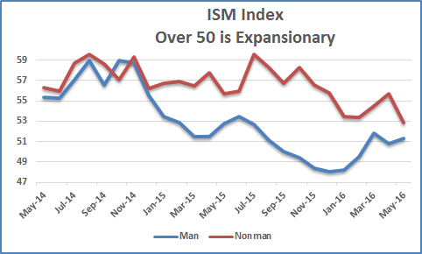

Slide 21


Slide 22
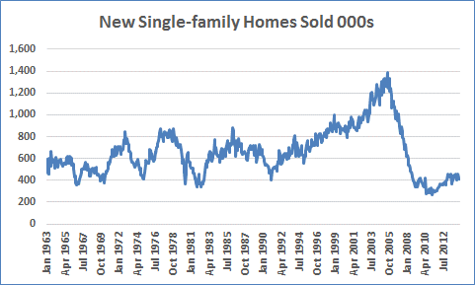
Average 1963-2000 = 635

Slide 23
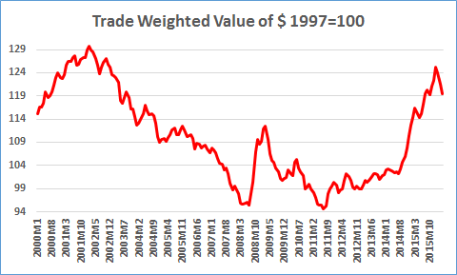

Slide 24
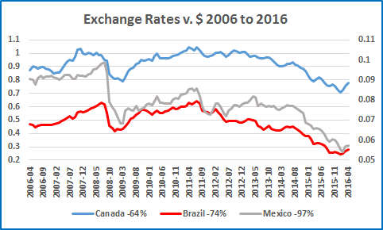

Slide 25
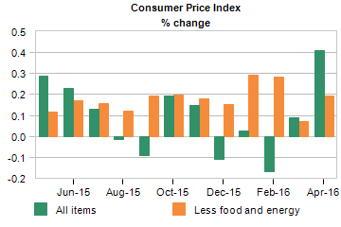

Slide 26
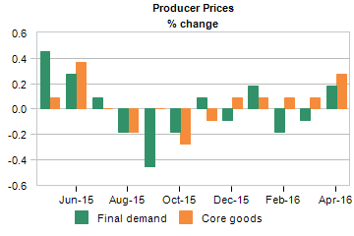

Slide 27
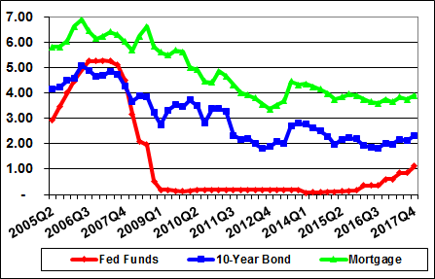
INTEREST RATES

Slide 28
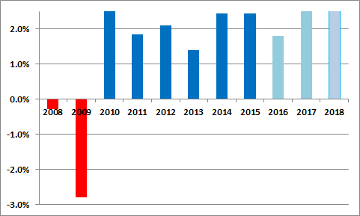
GDP Growth
(Percent growth SAAR)

Slide 29
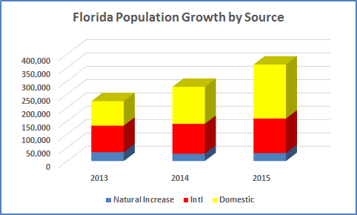

Slide 30
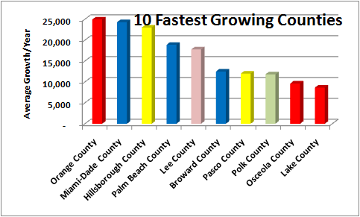

Slide 31
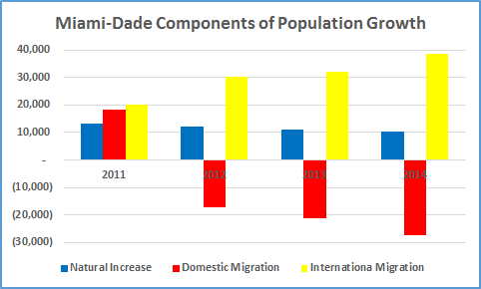

Slide 32
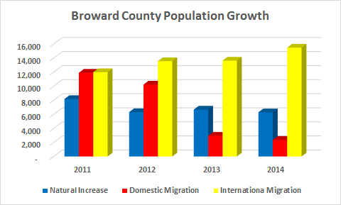

Slide 33
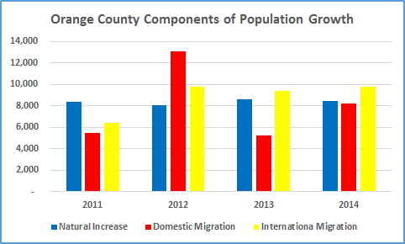

Slide 34
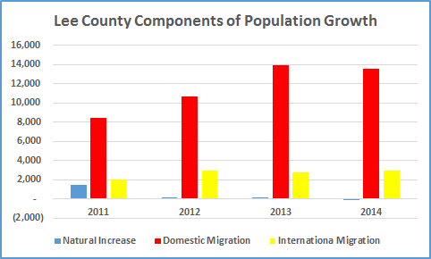

Slide 35
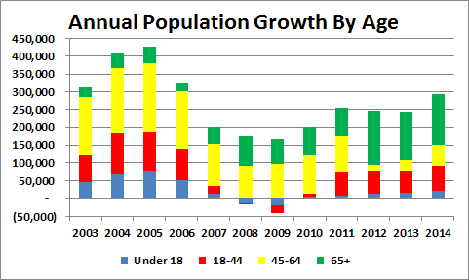

Slide 36
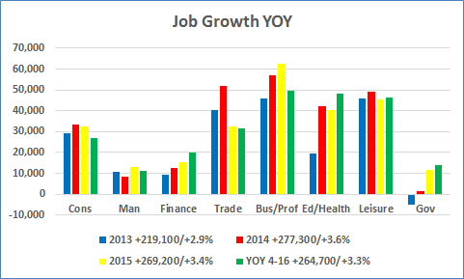

Slide 37
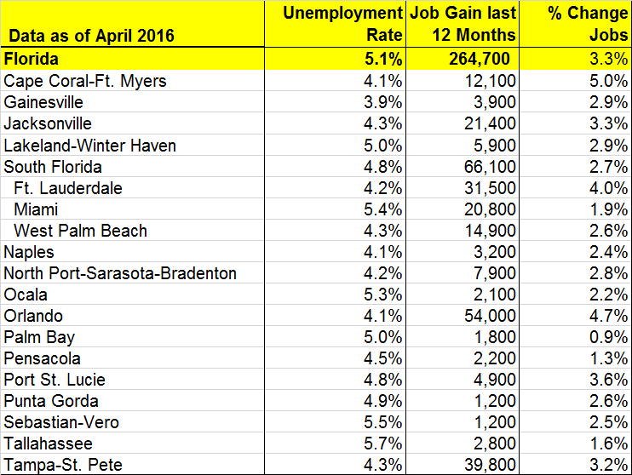

Slide 38
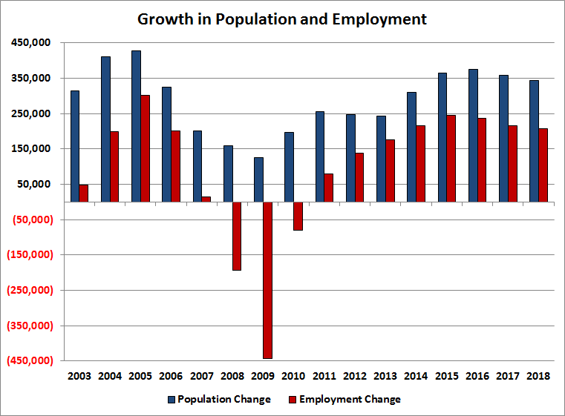

Slide 39
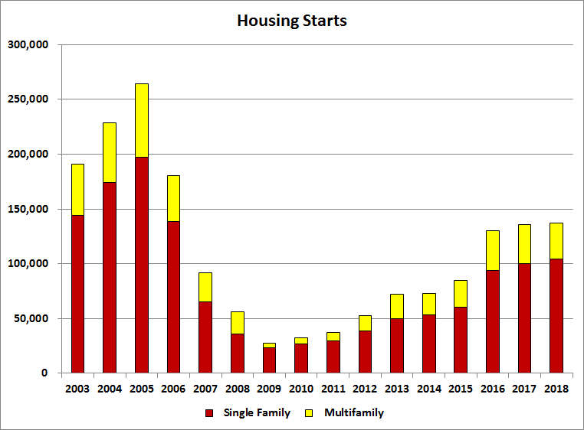

Slide 40
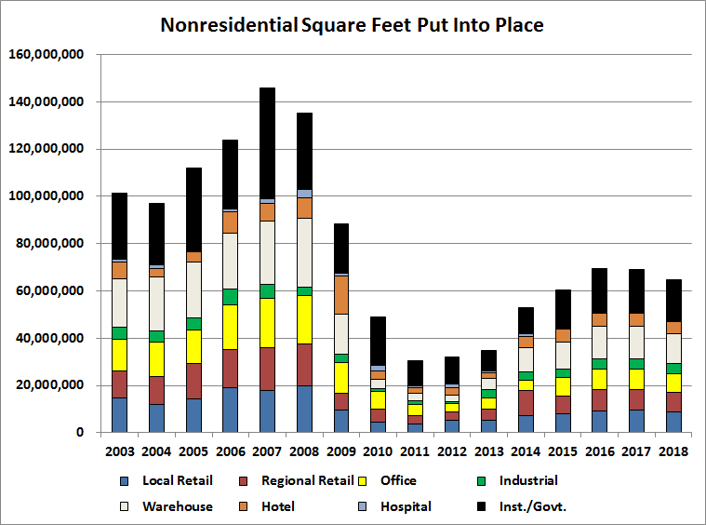

Slide 41
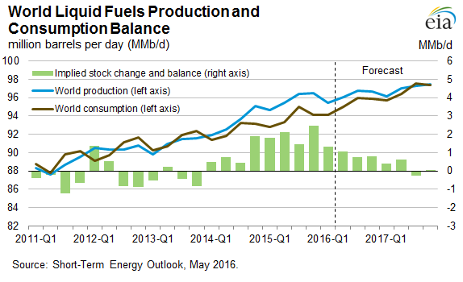

Slide 42
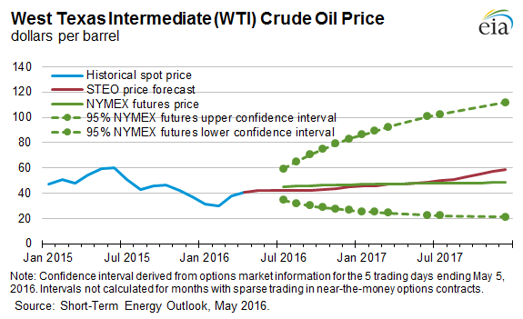

Slide 43
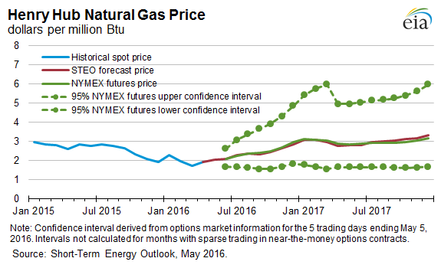

Slide 44
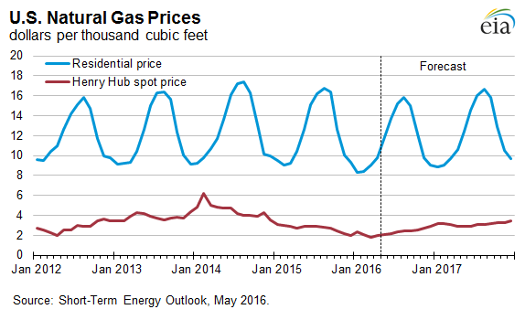

Slide 45
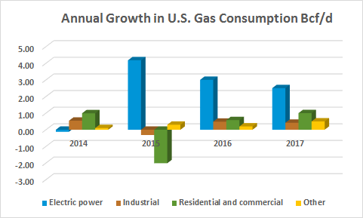

Slide 46
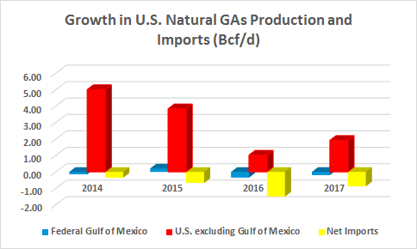

Slide 47
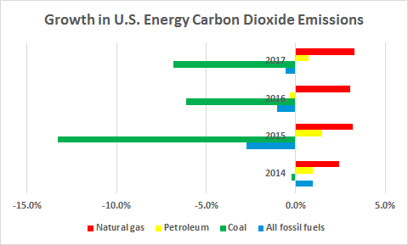

Slide 48
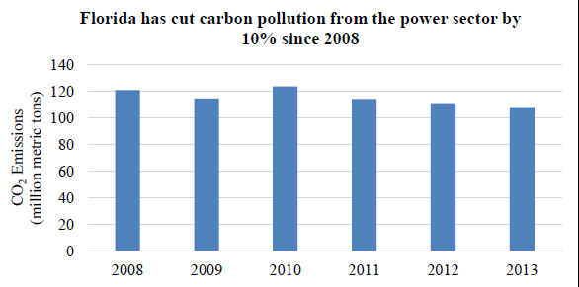
U.S. Clean Power Plan
Impact on Florida
Reduce carbon dioxide emissions nationwide by 32% from 2015 to 2030
Focus on power plants, especially coal-fired plants
Statewide increases in the deployment of clean energy up 20% since 2008
Mayors in over 75 Florida cities have joined the Mayors Climate Protection Agreement
Notes:
https://www.whitehouse.gov/sites/default/files/image/climate/Florida_Factsheet.pdf

Slide 49
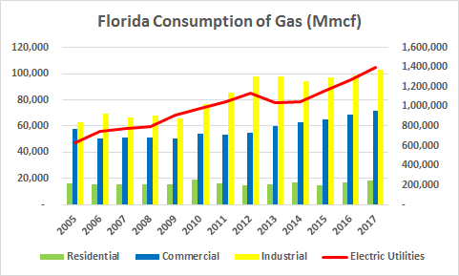

Slide 50
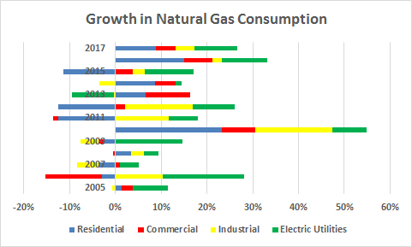

Slide 51

The End

