Slide 1
energy transfer interstate pipelines
Fgu annual meeting
June 8,2017

Slide 2
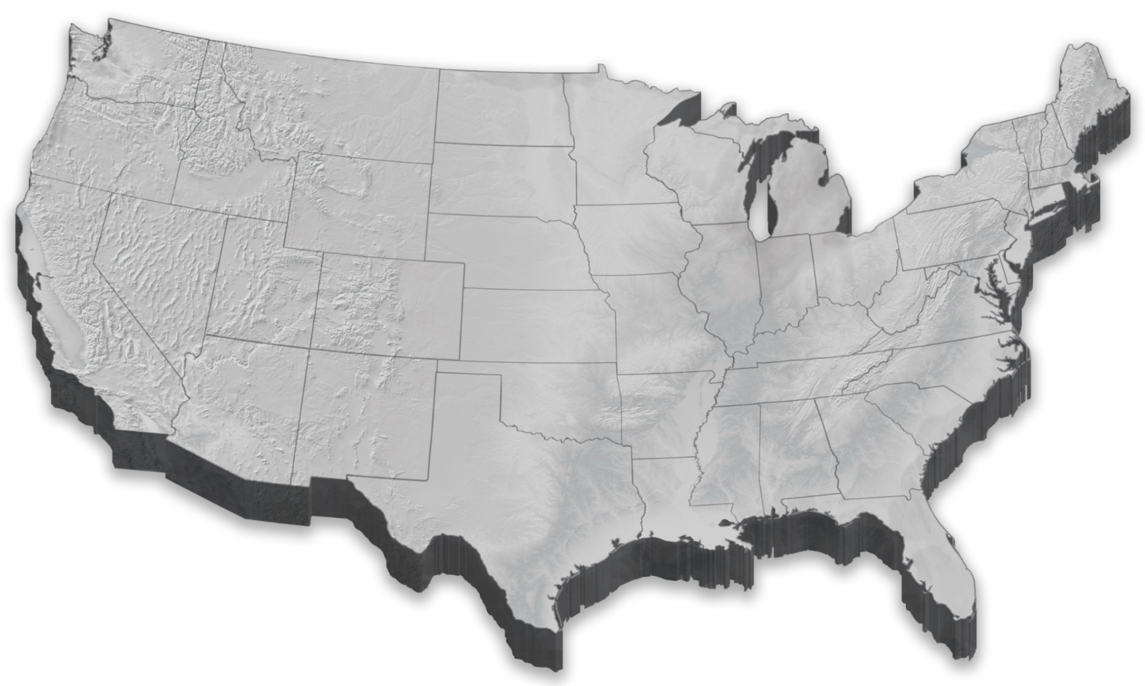









Energy transfer interstate assets today
 | Capacity (Bcf/d) | Miles of Pipeline
FGT ^{1/} | 3.1 | 5,400
PEPL | 2.8 | 6,000
Tiger | 2.4 | 195
SR | 2.3 | 1,000
TW | 2.1 | 2,600
FEP ^{1/} | 2.0 | 185
MEP ^{1/ 2/} | 1.8 | 500
TGC | 1.0 | 2,230
Gulf States | 0.2 | 10
Panhandle Eastern
Trunkline
Transwestern
Fayetteville Express
MidCont. Express
Gulf States
Florida Gas
Tiger
1/ Energy Transfer’s ownership is 50%.
2/ Operated by Kinder Morgan.
Sea Robin

Slide 3
pipeline industry dynamics
Supply growth in the Northeast
  Represented less than 3% of the nation’s supply ten years ago; now accounts for ~ 30% ^{1/}
Demand growth in the South
  Industrial – surge of gas-intensive projects (petrochemicals, methanol, etc.) concentrated along the Texas and Louisiana coastline
  LNG exports – pipeline feedstock averaging over 2 Bcf/day; multiple pipelines involved in the supply chain
  Exports to Mexico – U.S. supplies becoming the majority supply source for the country; driven by power demand
Pipelines reversing flow
  Every major longhaul pipeline from the Gulf Coast to the Midwest or Northeast is now operating in “backhaul” mode
1/ Source: EIA; represents the states of Ohio, Pennsylvania and West Virginia.

Slide 4
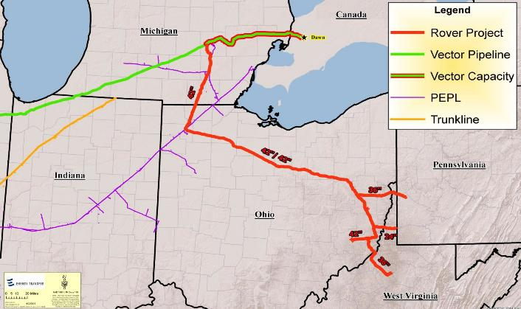
Rover pipeline
Contracted capacity on Vector to access Michigan and Ontario markets
Project Total:
713 miles of pipeline
Initial forwardhaul capacity of 3.25 Bcf/day
Ability to serve numerous markets in the Midwest, Canada and the Gulf Coast
Midwest Hub
(ANR and Panhandle)
Over 5.5 Bcf/day of initial receipt point capacity
Contracted capacity on Panhandle and Trunkline to access Gulf Coast markets

Slide 5

Rover pipeline southbound path
Rover
Panhandle Eastern
Trunkline

Slide 6
Other areas of supply growth
Associated Gas
  Midcontinent (SCOOP and STACK)
    The 2nd most active location for oil drilling
    Oklahoma has more rigs currently than any state other than Texas
  Permian
    The top oil producing region in the country (and the most important associated gas region)
    Contains 50% of U.S. oil rigs today
  Eagle Ford
    Low break-evens in areas with higher gas content
    Added over 50 rigs in the past year
Haynesville
  More rigs added this year than the Marcellus and Utica combined

Slide 7
short term supply outlook
Source: Wood Mackenzie: North America Gas Markets Short-Term Outlook May 2017.

Slide 8
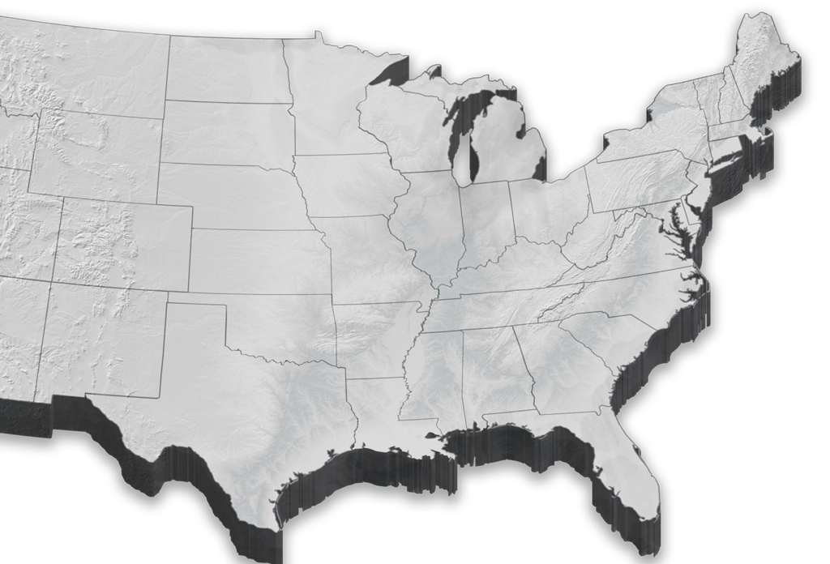

multiple paths to match supply & demand growth
Marcellus/Utica
SCOOP/STACK
The pipeline grid provides supply diversity for exports - and all other markets
Permian
Haynesville
Eagle Ford
LNG

Slide 9
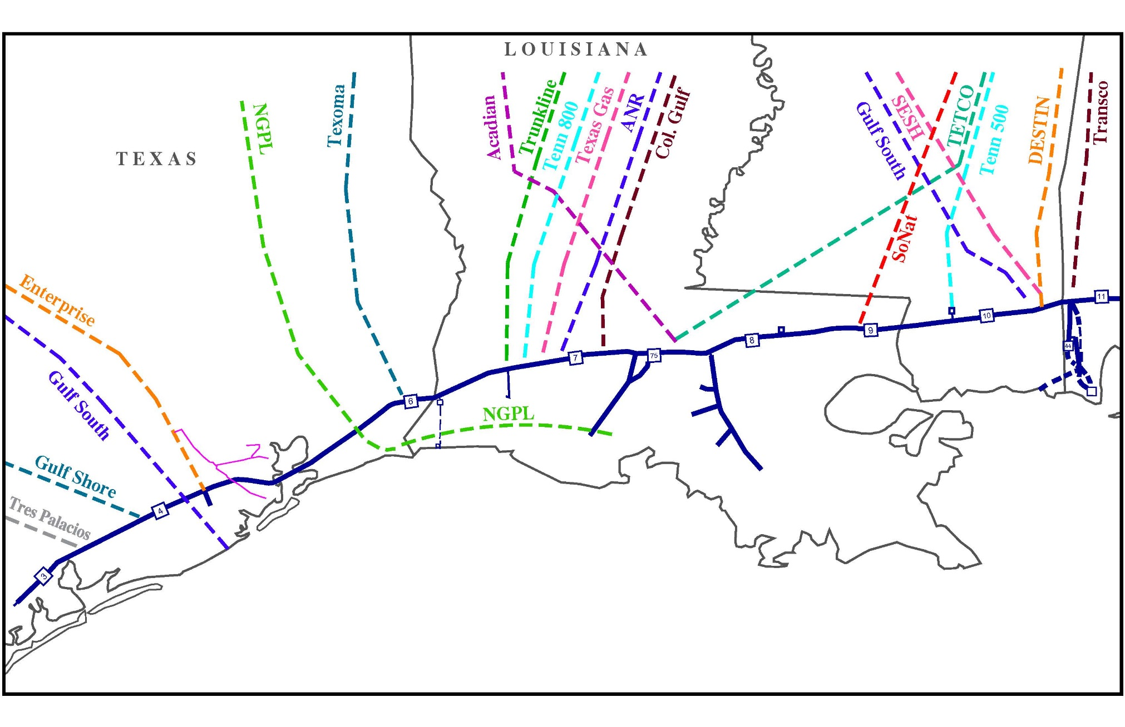
Fgt - supply diversity via pipeline interconnects

